Slide 1
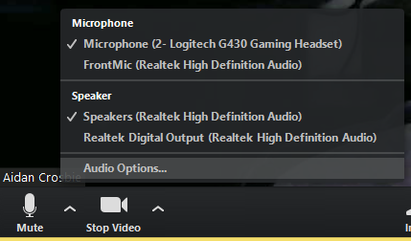
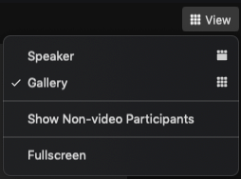
WELCOME!
As you enter, please complete the following:
Chat: Activate the chat sidebar area by clicking on the ‘Chat’ icon in the bottom of the screen.
Share:
a. Your organization
b. Where you’re joining us from today
Poll: Please respond to the polls on your screen by clicking the radial buttons that best correspond with your responses in the poll window.
ROOM ORIENTATION:
Manage Your Audio
Only presenters’ microphones will be enabled, please stay on mute
Manage Your Video
Enable Closed Captioning
Only presenters’ video webcams will be enabled for today’s session
There is the option to access live Closed Captioning for today’s session
You will see a notification above Closed Caption/Live Transcript in the meeting controls
Click the Closed Caption button to start viewing closed captioning at the bottom of your screen

Slide 2
Introduction to ITC’s Trade & Market Intelligence Data, tools and services
Mondher Mimouni and Ursula Hermelink
Presentation to USAID
7 July 2021

Slide 3
The UN body for design of policy recommendations to achieve economic and social development through trade and investment.
The forum to negotiate multilateral trade rules, monitor their implementation and handle trade disputes
ITC works with local and regional institutions and business people to build trade capacity.

Slide 4
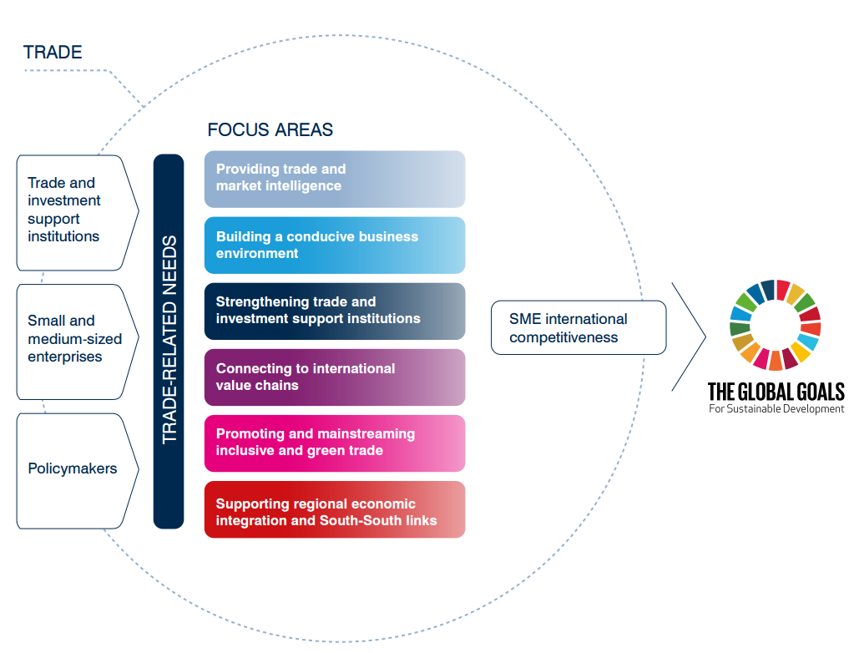
ITC’s 6 focus areas and goals towards SDGs

Slide 5
ITC’s Trade and Market Intelligence
Our areas of work
Country & regional diagnostics: business surveys and trade analysis
Trade information and analysis tools as “GPG”
Integrated solutions for Competitive Intelligence
Tailored services / analyses
Capacity building and outreach

Slide 6
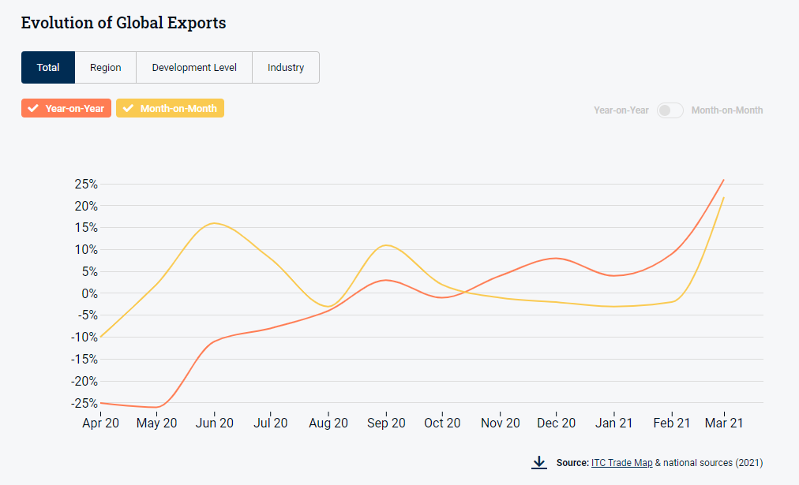
Global trade is bouncing back!
Source: ITC Trade Briefs May 2021
tradebriefs.intracen.org

Slide 7
How can businesses, business support organisations and governments monitor and take advantage of emerging opportunities?

Slide 8
Trade intelligence can help:
1
Navigate the full export journey
2
Enhance transparency and dialogue
3
Support evidence-based policies

Slide 9
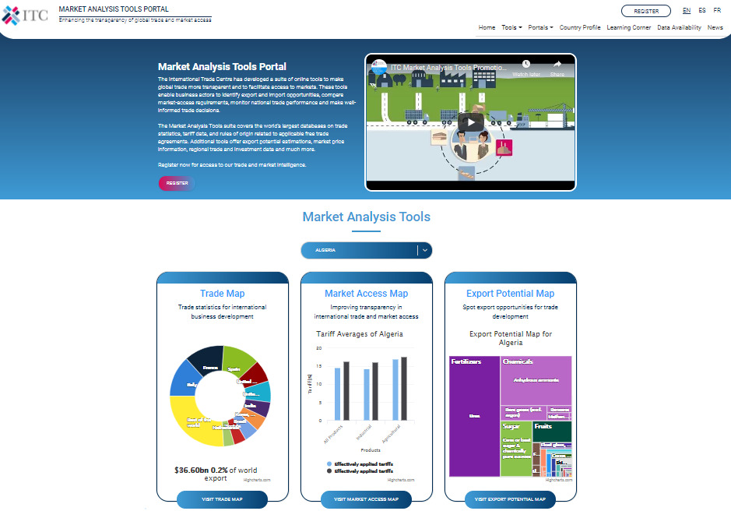
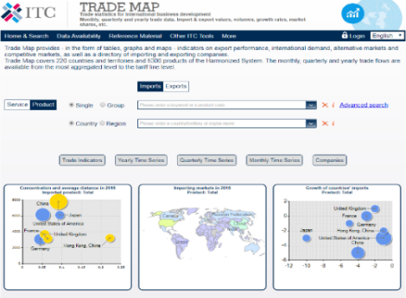
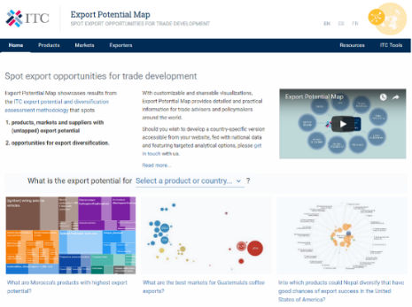
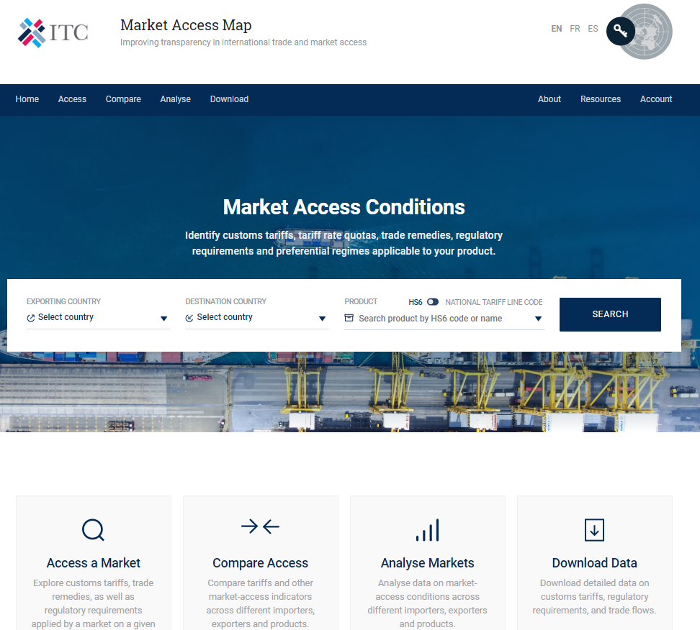
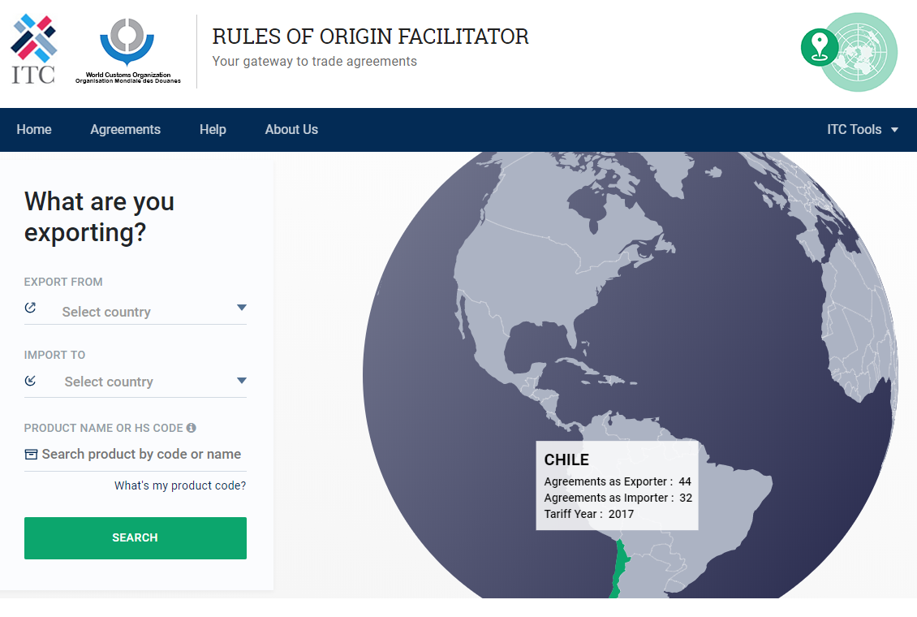
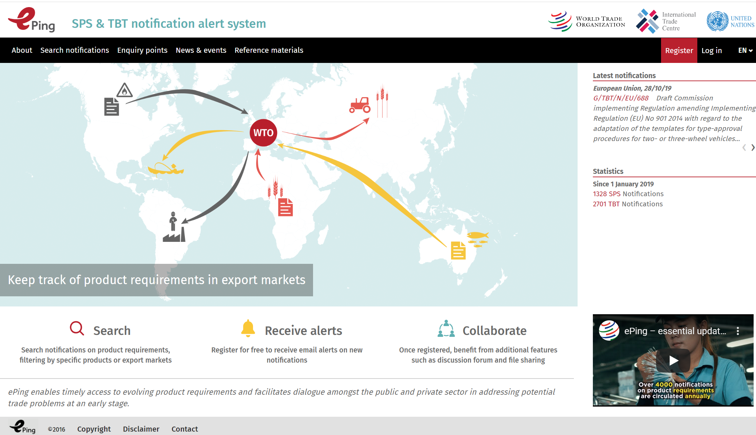
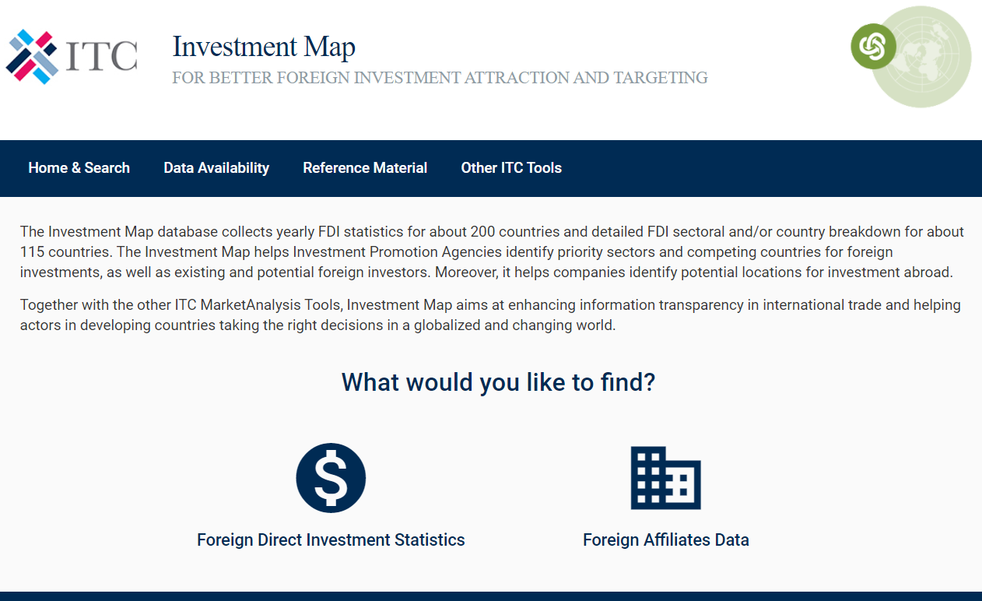
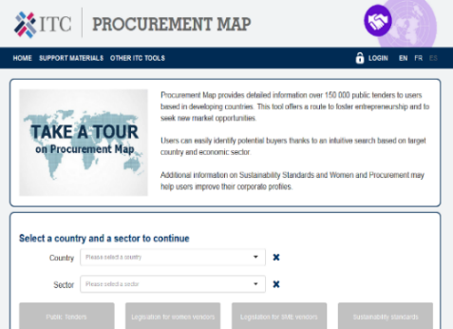
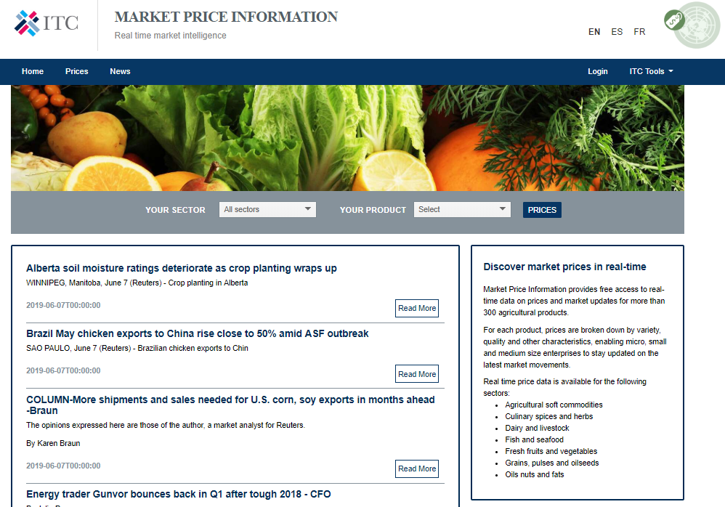
1
Navigating the full export journey
1m registered users to ITC Market Analysis Tools
Evaluate demand and track new trends
Assess emerging opportunities and market risks
Explore market access conditions
Identify regulatory requirements & new temporary measures
Consider market niches
Find partners (B2B)
Remain informed of public tenders and market prices

Slide 10
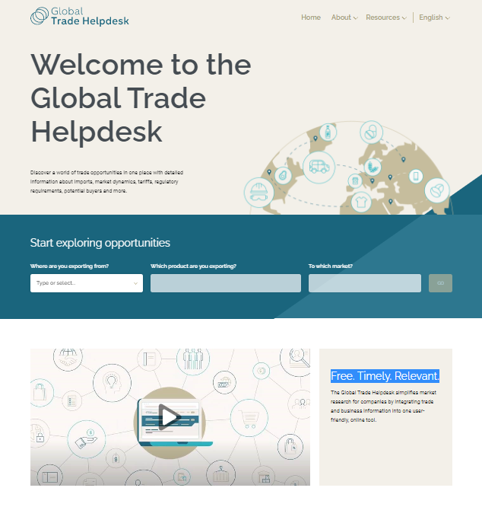
The Power of Data: Demo of the Global Trade Helpdesk platform
www.globaltradehelpdesk.org

Slide 11
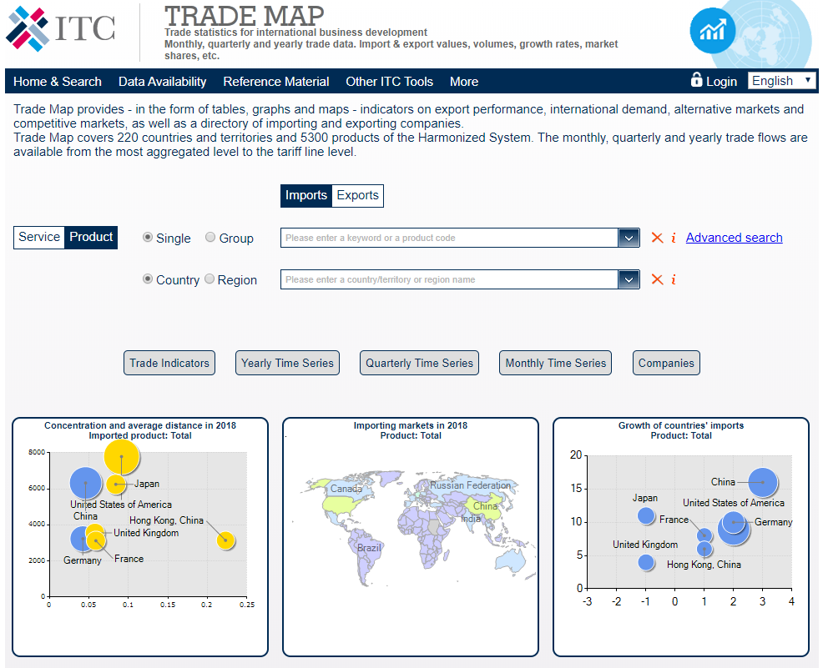
Analyse global trade flows, based on the largest trade flow database in the world.
www.trademap.org

Slide 12
Trade Map – Key characteristics
Geographical coverage
Information for over 220 countries and territories using data reported by 191 countries and territories for one or more years since 2001
Data for non-reporting countries is derived from mirror statistics
Product coverage
For the Harmonized System (HS): over 5,300 products at the 6 digit level
For the National Tariff Line: up to 10,000 products (for 175 countries)
Updates
Annual, monthly and quarterly trade data: all year round
Trade in services: twice a year
Indicators (trends) and AVEs: five times a year
Data sources
National Authorities
UN COMTRADE, produced by the United Nations Statistics Division

Slide 13
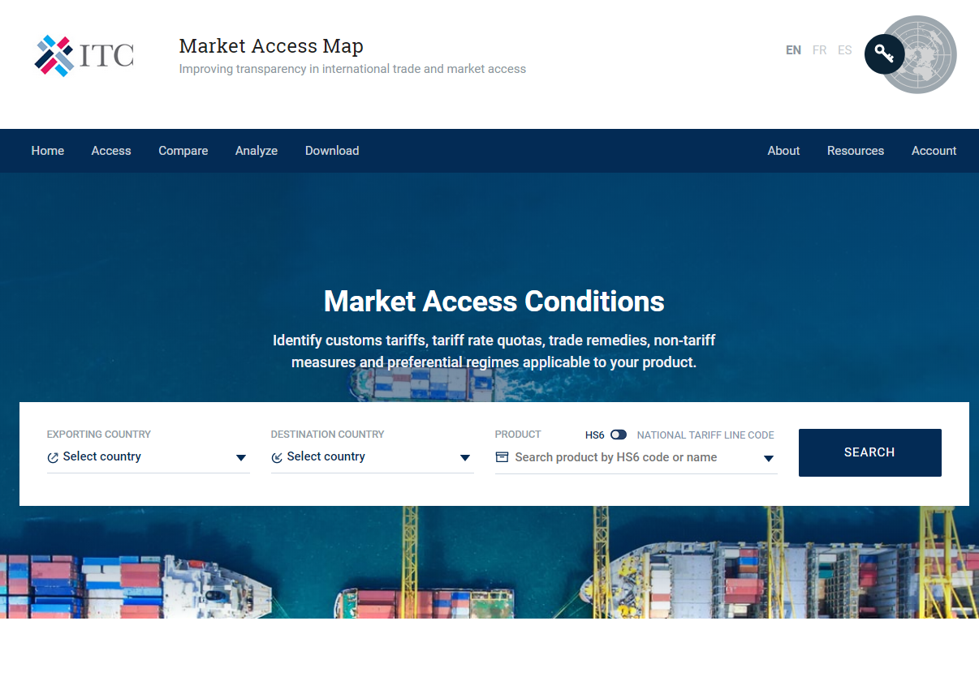
Analyze market access conditions applied to your products and compare them to conditions applied to competitors (Market screening)
www.macmap.org
Covid19 dashboard

Slide 14
Market Access Map – Key characteristics
Geographical coverage
tariffs applied by 201 countries to the products exported by over 239 countries and territories
Data coverage
Ad valorem tariffs; specific tariffs; tariff rate quotas and antidumping duties; sanitary and phytosanitary measures, technical measures and other non-tariff measures
Preferential treatment coverage
Covers most bilateral and regional agreements, and unilateral preferences
Rules of origin and certificates of origin also included for most agreements
Data sources
Tariff data collected by ITC from national sources
NTMs collected jointly with a consortium of international organizations through in the field and online research
Trade remedies data collected by ITC from national sources

Slide 15
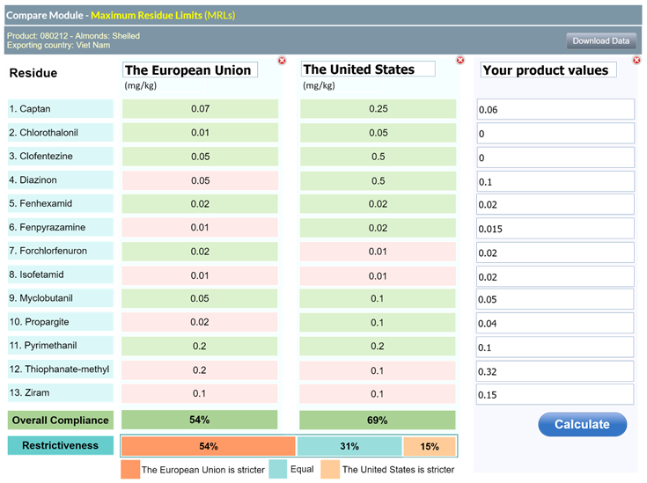
Talking about non-tariff measures…
Heading towards detailed comparability of NTMs (thanks to USAID! ☺), which could look like this:

Slide 16
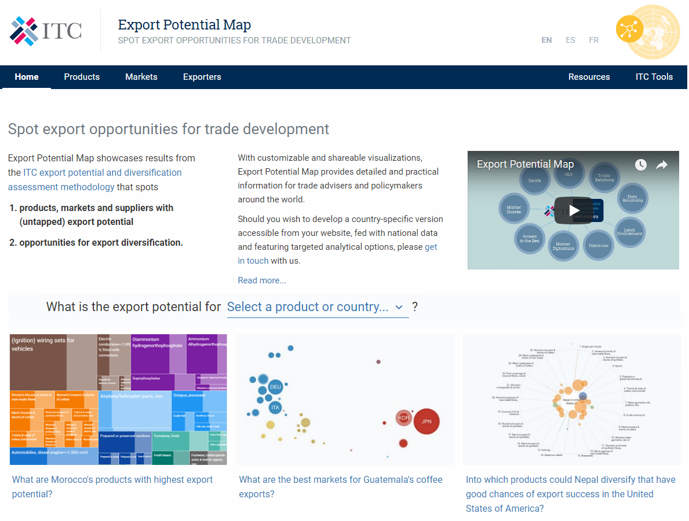
Identify products, markets and suppliers with export potential and discover new products with favourable chances of export success.
exportpotential.intracen.org

Slide 17
Export Potential Map – Key characteristics
Key focus
Economic model that draws on trade, tariff, GDP and geographic data
Characteristics
Evaluate export country’s supply capacity, target market’s demand, tariff conditions, bilateral links between the exporting country and target market
Focus beyond damaging and hazardous products
User friendly interface with customizable, dowloadable and sharable visualizations
Country-specific versions with additional customized analytical options on request
Coverage
222 countries and territories
4,064 products
Stakeholders
Trade Advisers, policy makers, private companies

Slide 18
Other tools: https://marketanalysis.intracen.org/
Rules of Origin Facilitator (https://findrulesoforigin.org )
Product-specific rules of origins for 150+ trade agreements; information on certification cost and procedures; comparable across agreements
Procurement Map (https://procurementmap.intracen.org)
Information about 150,000 public tenders, awarded contracts in 180 countries, covering 95,000 products & 9,400 services, legislation for women vendors from 7 countries, legislation for SMEs from 107 countries
Investment Map (https://www.investmentmap.org)
FDI flows and stocks for more than 200 countries and territories, industry and country break down of FDI flows and stocks for more than 115 countries; location, sales, employment and parent company for over 175 000 foreign affiliates located in developing countries and economies in transition
Sustainability Map (https://www.sustainabilitymap.org)
250+ sustainability standards applicable to more than 80 sectors and 180 countries; Comprehensive market information about 14 major sustainability standards
Market Price Information (https://mpi.intracen.org)
Real-time data on prices for 300+ agricultural products

Slide 19
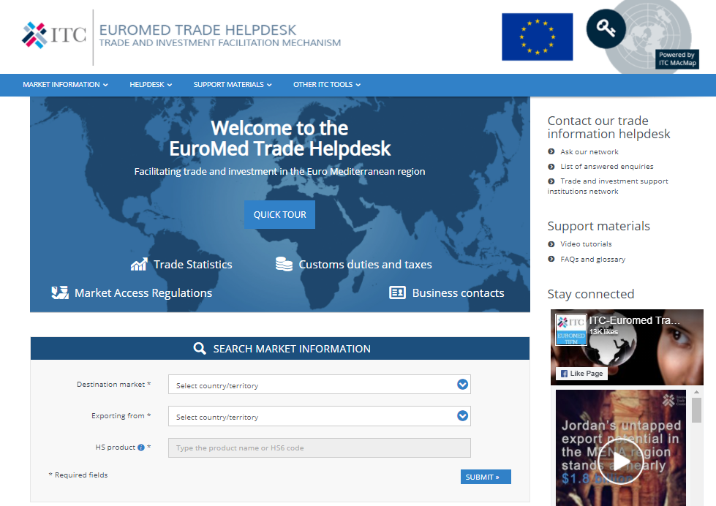
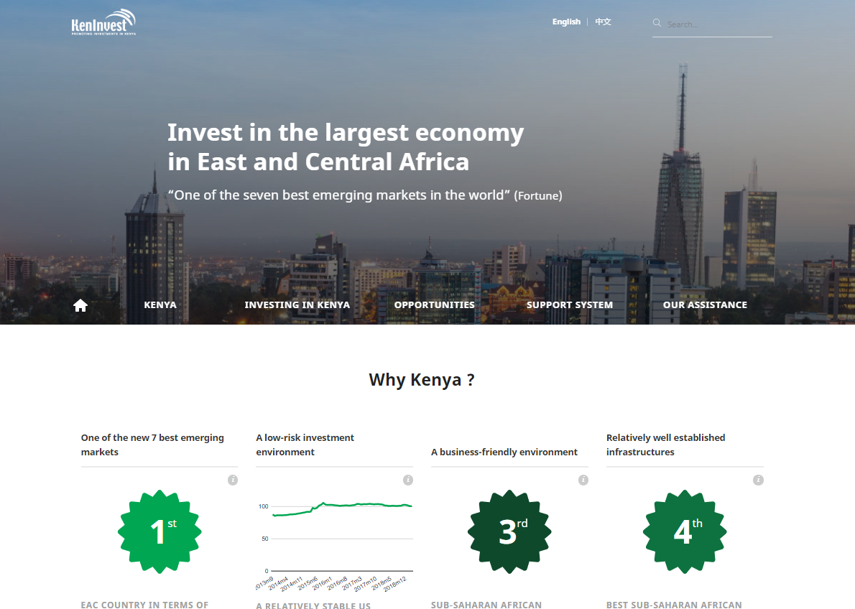
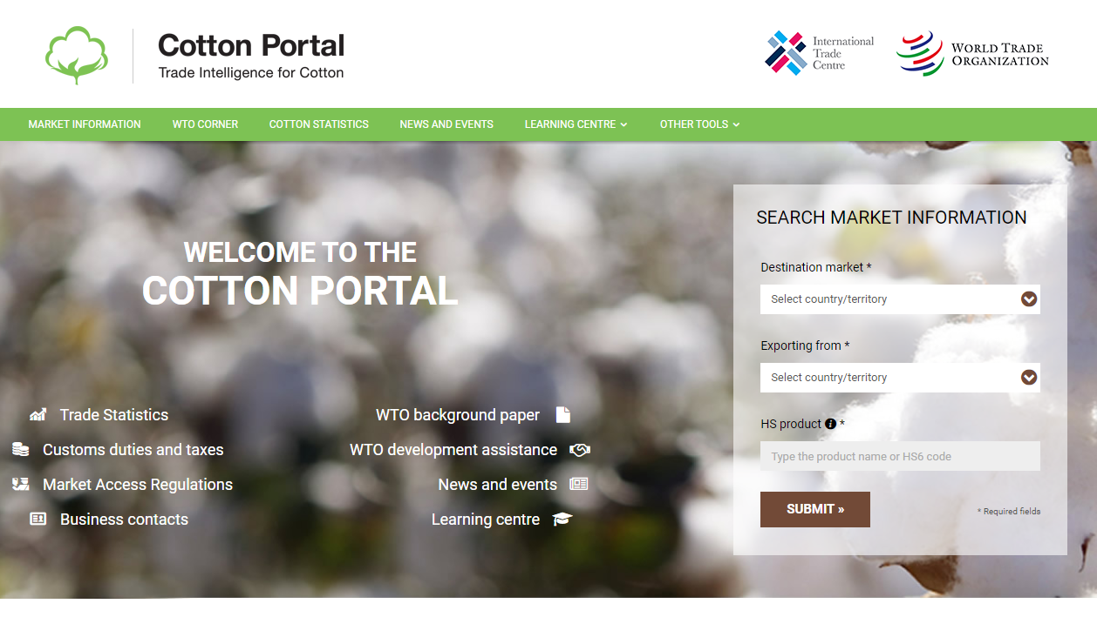
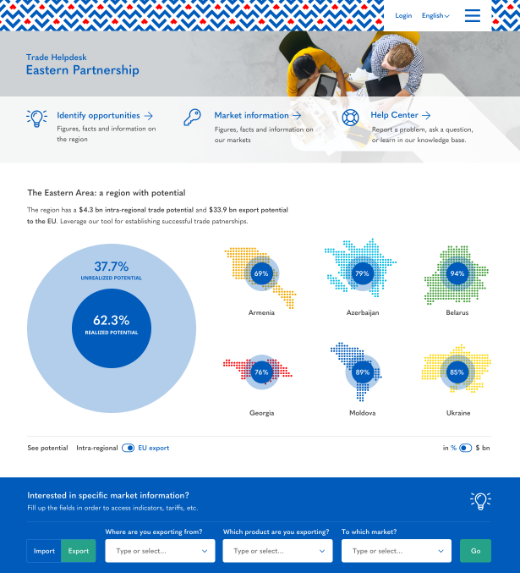
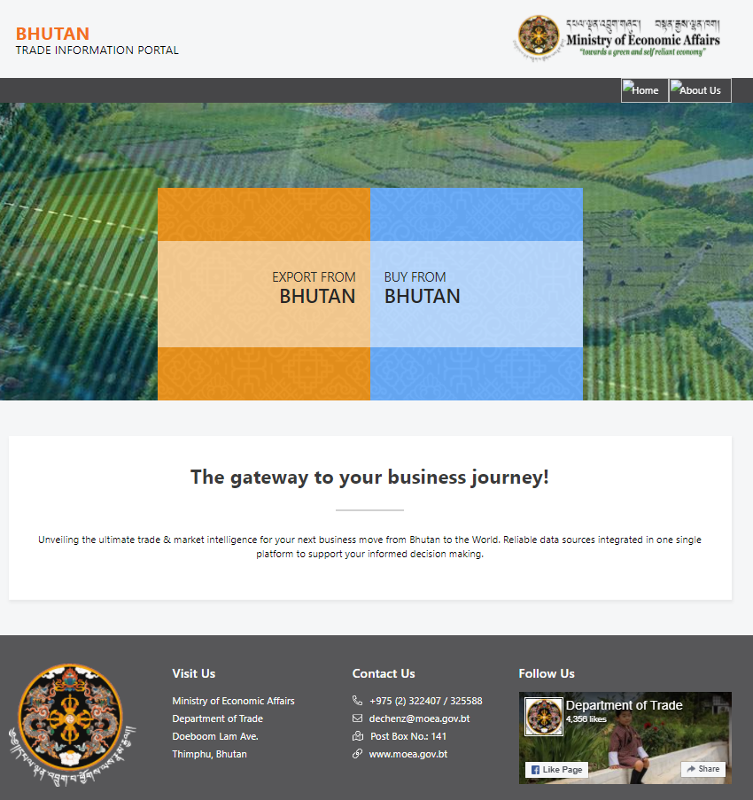
Promote regional trade
Examples of integrating data for different audiences
Boost national competitiveness
Empower small businesses
Euromed, Central Asia, EaP
Bahamas, Bhutan, EAC countries
Cotton portal, Global Trade Helpdesk

Slide 20
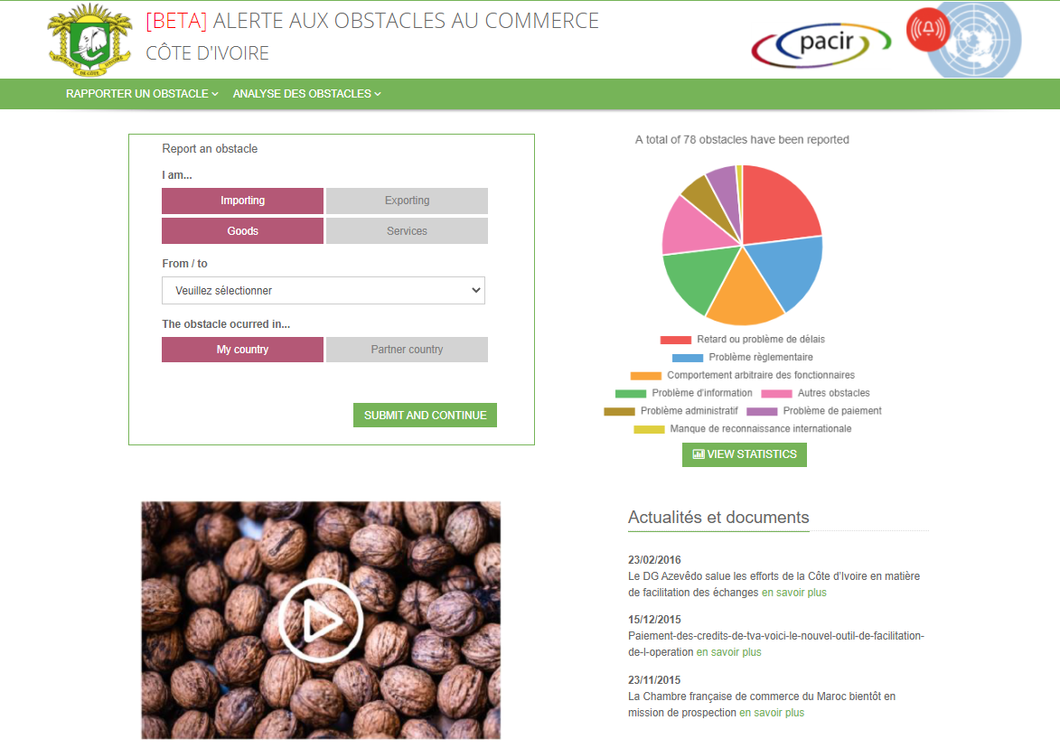
2
Enhancing transparency and dialogue
Get alerts on new WTO notifications and call for comments
Connect firms and public authorities to solve trade issues
Monitor trade obstacles and their resolutions

Slide 21
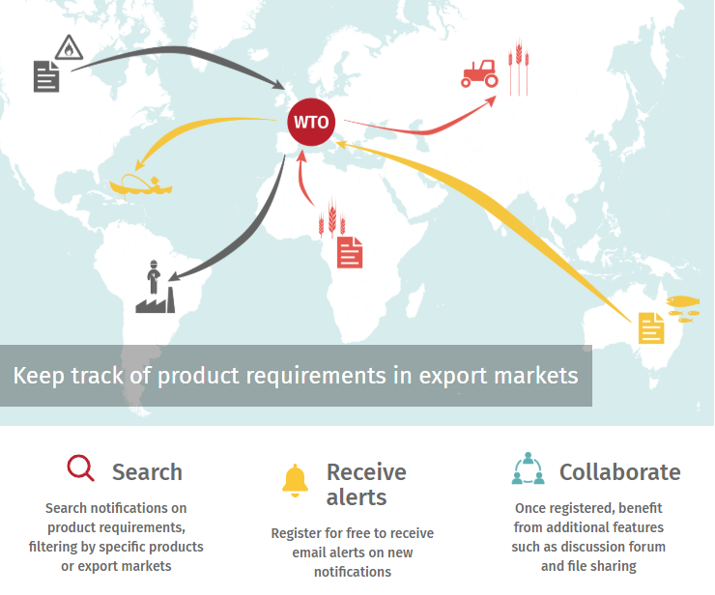
Avoiding costly mistakes: Mitigating the negative impact of changes in regulations
2.1 ePing
(epingalert.org)
“Countries change their laws so quickly. How can I keep up?”
A frequently voiced concern among the 35,000 exporters interviewed by ITC across the world
Example ePing: ITC alerts SMEs about changes in regulations for products and markets of their interest, including changes that have not yet been implemented
🡪 solving trade obstacles before they occur
www.epingalert.org
“Thanks to ePing, I am now able to receive timely information on changes in technical regulations concerning fisheries, share it with our members and engage in discussions on the chat forum relating to notifications of concern and help members, for example when our companies face problems with compliance.”
Head of the Uganda Fish Processors & Exporters Association
SMEs are informed about relevant regulatory changes (including temporary COVID-related measures!) and can take action to adjust
Policy makers are enabled to clarify implications of changes and to report concerns back to the multilateral level

Slide 22
2.2 Trade Obstacles Alert Mechanism
An online platform which connects companies and relevant agencies allowing them to exchange information about trade obstacles;
An institutional mechanism that ensures the cooperation of the different actors involved in the identification and resolution of problems reported through the online platform.
🡪 Assists national and regional authorities in the development and implementation of trade facilitation policies
🡪 Monitoring tool for national and regional trade facilitation committees

Slide 23
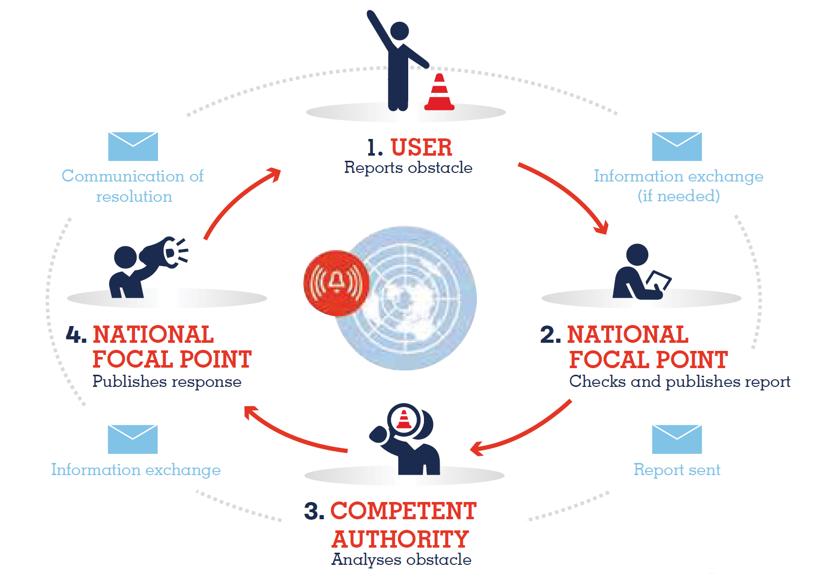
The Trade Obstacles Alert Mechanism – how does it work?
Network of national
focal points
Monitor and ensure the
functioning of the mechanism

Slide 24
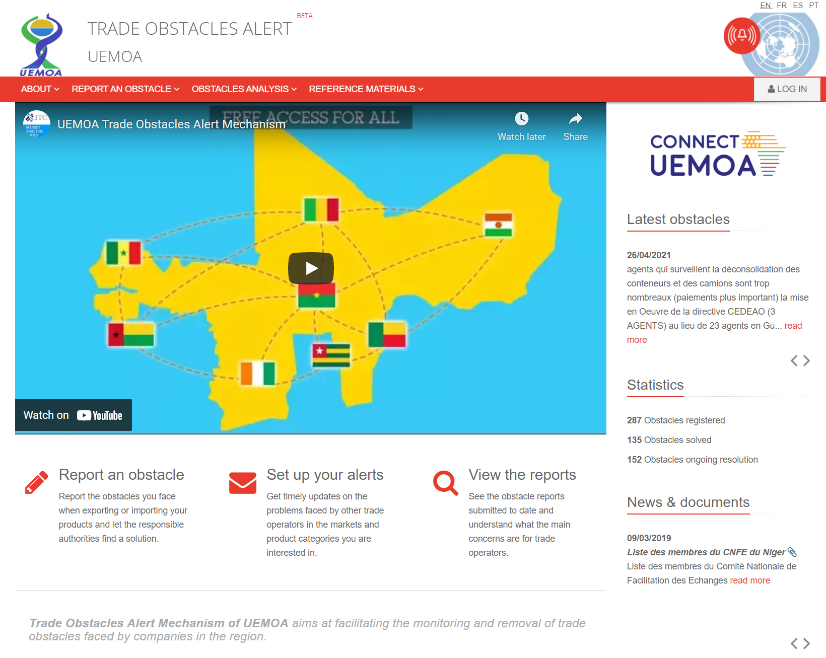
Connecting national mechanisms to strengthen regional integration

Slide 25
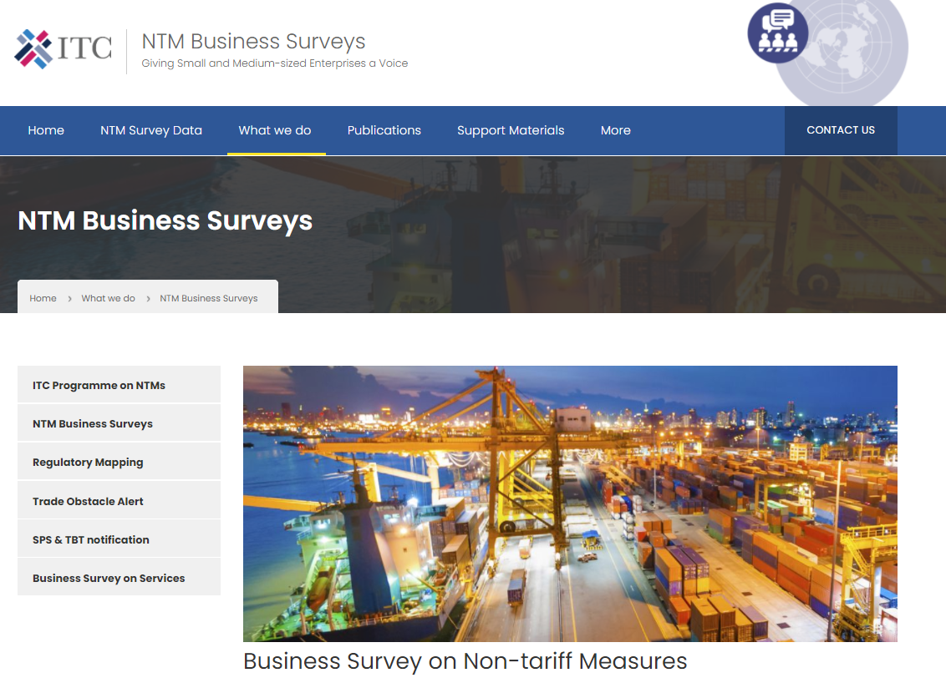
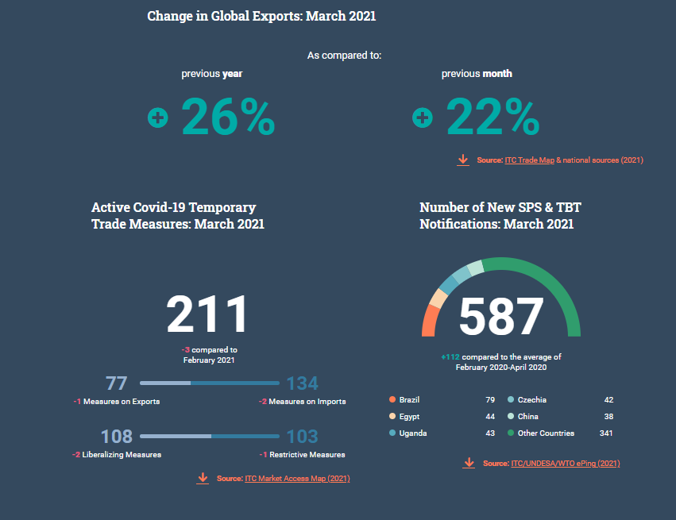
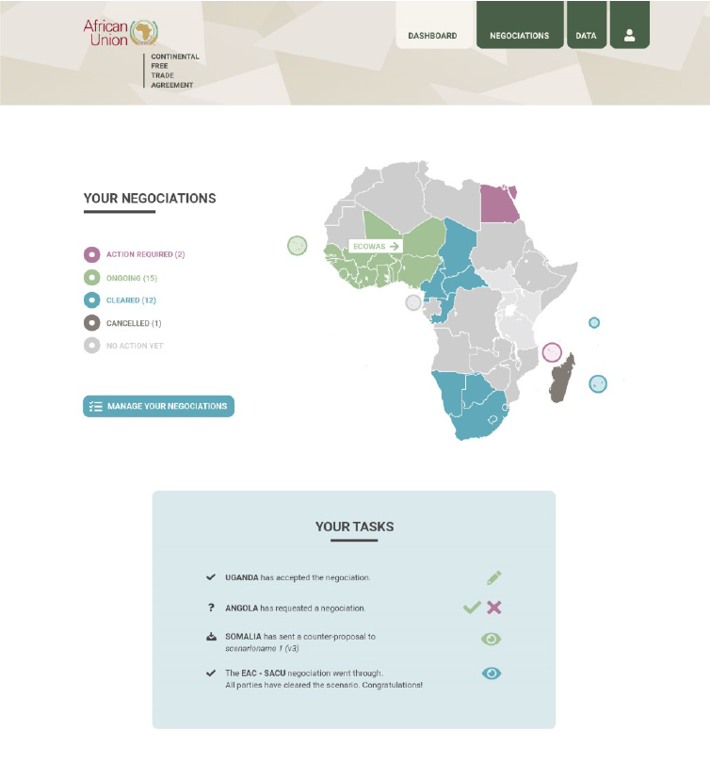
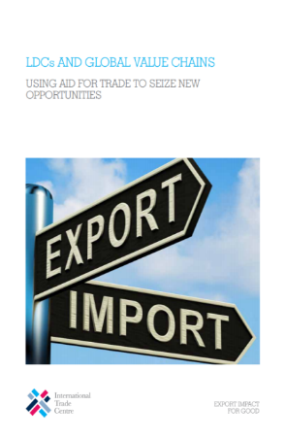
3
Supporting evidence-based policies
Monitor the state of trade
Analyse market access conditions
Identify trade barriers
Assess the impact of policies
Support the development of export strategies
Conduct trade negotiations
Identify promising value chains

Slide 26
Country & regional diagnostics
Providing evidence for trade advisory and policymaking
47% of LDCs trade potential remains unused
20% of exporting businesses are women-led
50% of micro and small companies never report trade obstacles they face
Using business surveys and trade analysis to provide evidence for trade advisory and policymaking
Tariff cuts under the AfCFTA could boost COMESA’s intra-African trade by $1.5 bn
10% of exporting businesses are youth-led
Procedures, not regulations, are the bigger challenge for exporters and importers
Although supposed to enable market access, rules of origin are the third most challenging non-tariff measure to deal with after SPS and TBT
Realizing the export potential could create over 3 million new jobs

Slide 27
Business surveys on trade obstacles
3.1 Capturing the MSME voice
…. and bringing it to the policy making table
Objective: Providing an evidence base on regulatory and procedural trade obstacles encountered by businesses for better-tailored decision making (trade strategies, TRTA, advocacy, trade facilitating measures)
How? Interviews with businesses, representative by sector, capturing:
Products (HS6) / type of service(s) delivered
Mode of supply (services)
Export destination / import origin (goods) / origin of foreign clients (services)
Types of obstacle(s) encountered for each pair of product/service and market, including regulatory and procedural obstacles, lack of information, issues related to the business environment, etc.
Companies’ recommendations: what needs to change
Company characteristics (women/youth ownership/management and employment, company size, etc.)
The results feed into public-private dialogue processes establishing recommended actions to overcome identified trade impediments

Slide 28
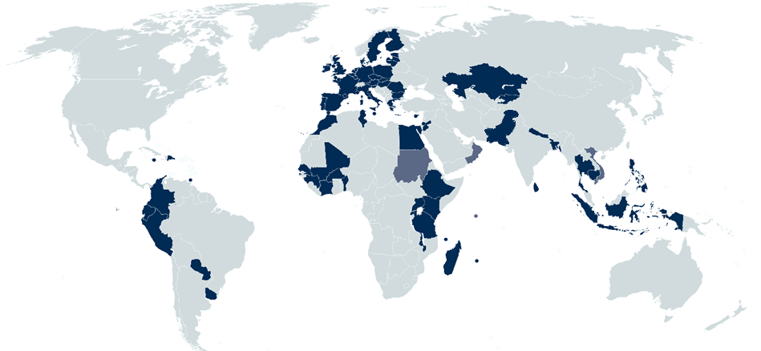
… for greater impact on the ground
Capturing the MSME voice (2/2)
Capturing the voices of MSMEs and bringing it to the policy making table
73
Countries
Example “over-regulation”: opportunities for simplification
ITC’s business survey on NTMs in Mauritius highlighted that companies suffered from what they felt were excessive import licensing requirements.
Stakeholders, including government agencies, concluded that a simplification was warranted and that some licenses may no longer be needed.
“A direct consequence of the survey and the ITC consultations was the elimination of the need for Tea Board clearance of rooibos tea imports. This resulted in reduced time and cost for my business.”
A Mauritian tea importer
… creating unprecedented insights
Share of women-owned and managed firms by company size, sector and country
Differences between women and men-led firms
Share of micro and small firms
Services trade activities of MSMEs and barriers faced
Youth and female employment in trading firms
More than 70 import licence requirements have to date been eliminated by the government after a thorough review of existing requirements
35,739
Interviews with exporters and importers to date
… adapting to emerging needs
Information on consequences of COVID and mitigating strategies
Call for feedback on trade with the EU and the UK pre and post-Brexit

Slide 29
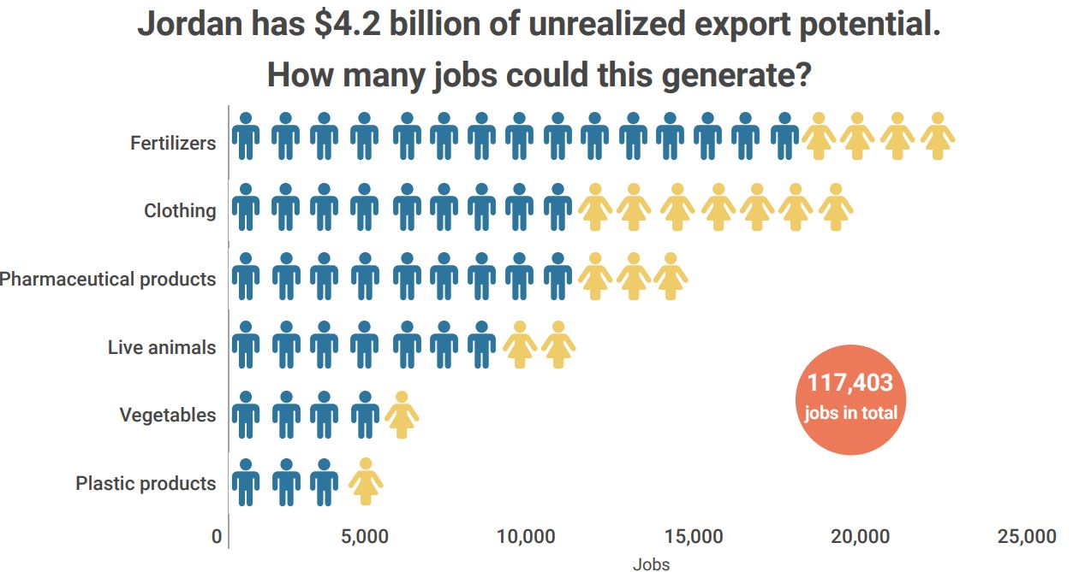
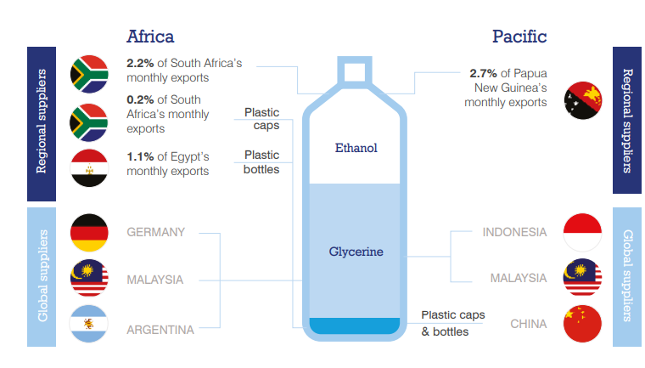
3.2 Tailored trade analysis & research
Jordan has $4.2 billion of regional export growth potential.
How many jobs could this generate?
What are the best opportunities for Greece’s services exports?
Greek exporters of personal travel services have $28 million of untapped export potential in the Japanese market.
Which effect does Lao PDR’s graduation from LDC status have on trade?
How can regional cooperation support the development of value chains?
Lao PDR could lose $102 million in exports. Compensatory strategies include
Seek GSP+ to reduce losses by 65%
Use $6.3 mn untapped potential in EU through targeted trade advisory
Diversify to Vietnamese market

Slide 30
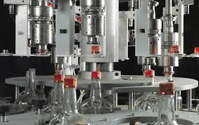
Value chain development
Promising value chain development opportunities feature:
Supply capacity
key inputs that are available locally
close proximity to new value added products
competitive regional suppliers of complementary inputs
Market potential
high projected import demand, favourable market access conditions and strong trade linkages
Foreign sourcing
Foreign sourcing
+
Market A
B
C
Validation of results and collection of evidence on potential bottlenecks through interviews with sector experts
Guidance to trade advisers, policy makers, private companies

Slide 31
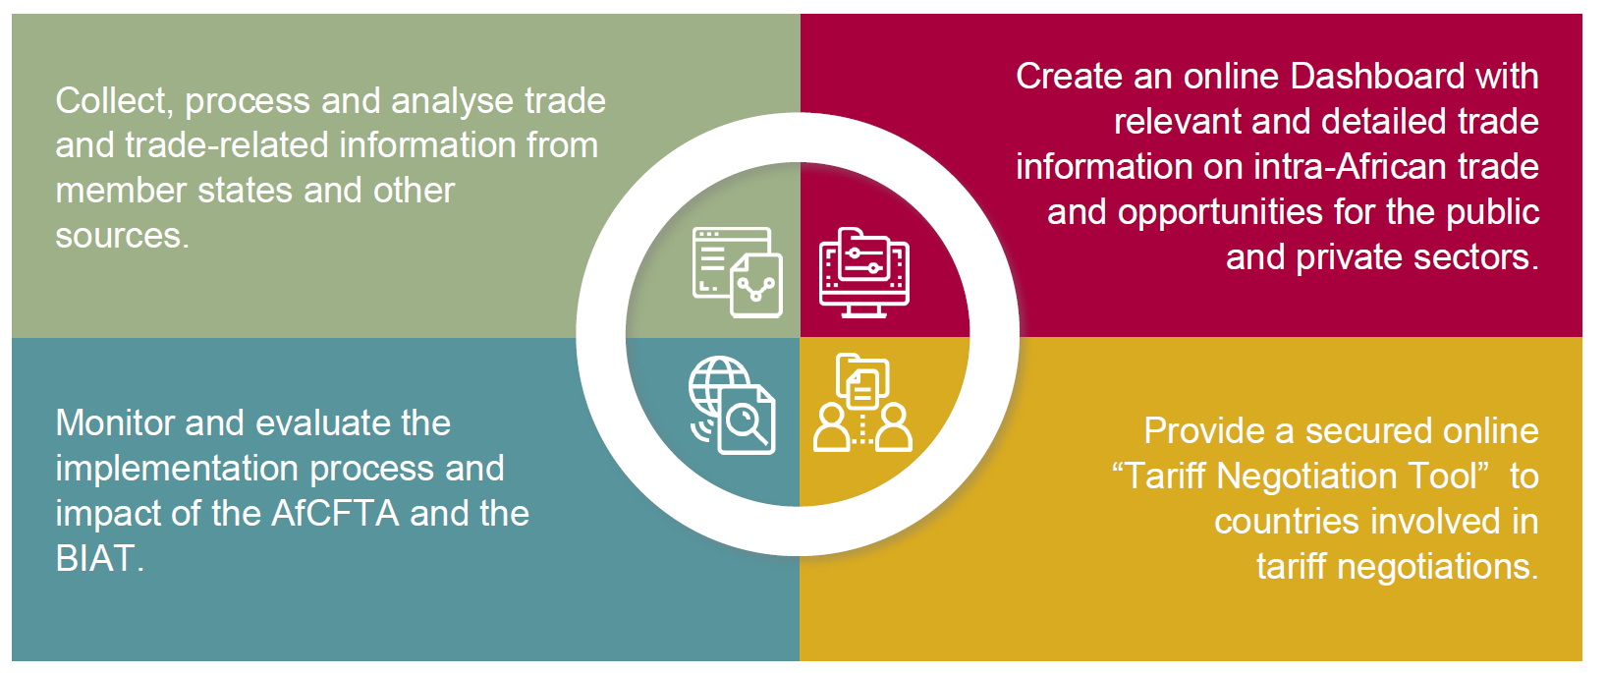
3.3 Supporting and Monitoring Regional Trade Integration
The ATO provides updated and reliable data to inform business and policy decisions and to monitor the implementation process and impact of the AfCFTA. https://ato.africa

Slide 32
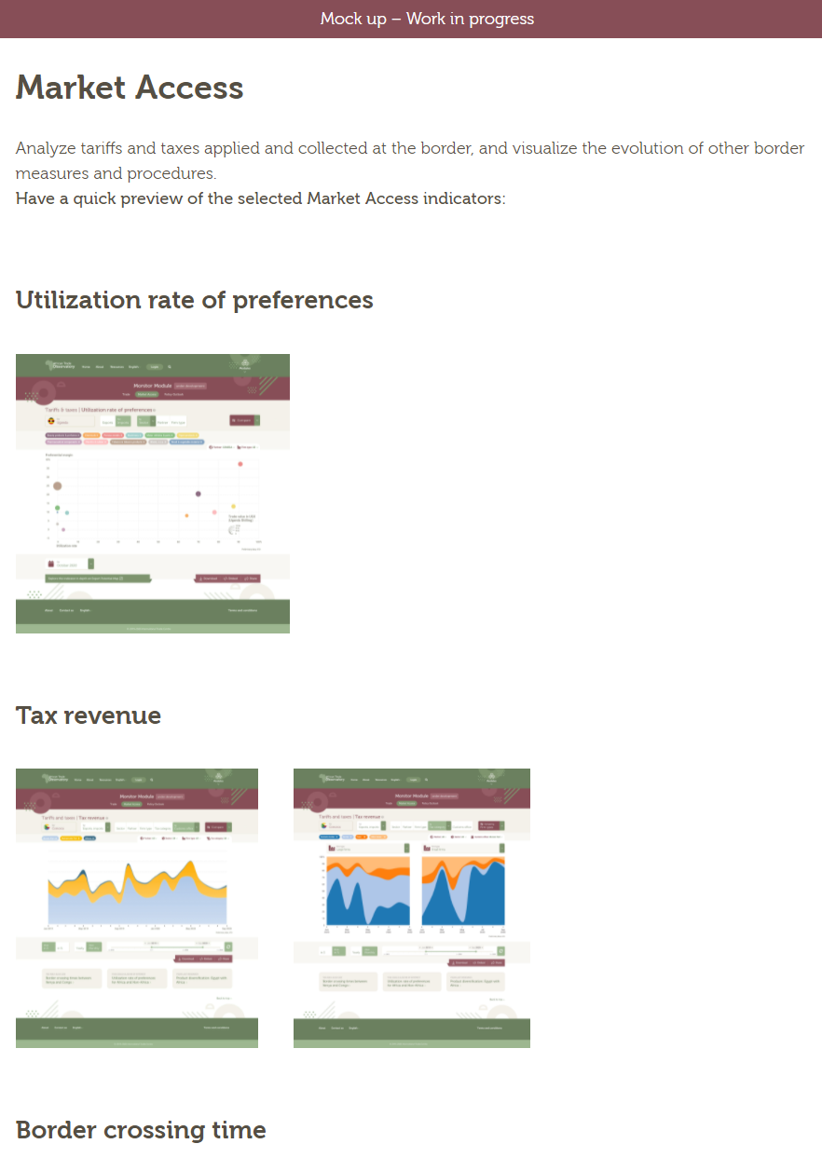
Supporting and Monitoring Regional Trade Integration
ATO Monitoring
ATO Tariff Negotiation Tool

Slide 33
Other areas of work
Capacity building on trade concepts, ITC’s market analysis tools, data analysis methodologies and data collection
Conceptual work (e.g. international classification on non-tariff measures, development of new assessment methodologies)

Slide 34
What questions do you have?

Slide 35
THANK YOU FOR ATTENDING TODAY!
Before you exit out of the room today, please:
1. Share in chat: What additional comments/questions do you have for our presenters?
2. Poll: Please reply to the poll that is on your screen by clicking the radial buttons that best correspond
with your responses in the poll window.
3. For more information, you may contact Paul Fekete (pfekete@usaid.gov)
marketanalysis.intracen.org
marketanalysis@intracen.org
@ITC_MktAnalysis
ITCmarketanalysistools

