Slide 1
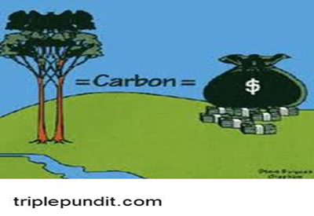
Analysis and Financing for REDD+ and Carbon Markets
Dr. Eric Hyman
USAID/Economic Growth, Education, and Environment
Bureau
July 1, 2019

Slide 2
What Are REDD and REDD+?
Purpose: Create financial value for carbon stored in forests in developing countries
  Donor and multilateral development bank results-based funding
  Market-based mechanisms allowing transfer of mitigation outcomes (many developed countries supported to have option for forest carbon offsets)
REDD: Reducing GHG Emissions from Deforestation and forest Degradation
REDD+: REDD plus
  Conservation of forest carbon stocks
  Sustainable management of forests
  Enhancement of forest carbon stocks
Social benefits viewed as co-benefits
  Better governance, new livelihood options, land tenure, indigenous peoples rights
  May also be supported by Cancun, World Bank, or Green Climate Fund safeguards, where applicable

Slide 3
Slow Process of REDD and REDD+
First negotiated under United Nations Framework Convention on Climate Change (UNFCCC) in 2005
Key UNFCCC decisions on REDD+ completed at COP 19 in Warsaw in 2013
Final parts of REDD+ rulebook completed in 2015

Slide 4
Required Elements For REDD+
National REDD+ strategy
  Governance and legal structures
    Carbon rights and ownership
    Dispute resolution mechanisms
  Social and financial structures
    Consultation process and mechanisms (national and multilateral requirements)
    Funding streams and distribution of results-based payments
  Action plan/road-map
National forest reference level (baseline)
National forest monitoring, reporting, and verification system (MRV)
Safeguards information system
Notes:
ALTERNATE:
What does REDD Readiness mean? How do we know when a country is “ready” for REDD? For those countries where we see pilot projects generating carbon offset credits from avoided deforestation, or from carbon sequestration, are they not by definition ready for REDD, since they are already doing it? Let us try to answer those questions, both because REDD Readiness can be confusing and because that is a key focus of most Sustainable Landscapes programming for now.
From the perspective of the international negotiators, those pilot projects have been very useful in highlighting that REDD cannot be developed completely at that scale. Leakage is a challenge. Also, the drivers of deforestation cannot always be addressed by individual projects. So the UN-REDD Programme, the Forest Carbon Partnership Facility, and others have identified several elements of national REDD Readiness that each country should have in place able to participate in REDD at different scales.
That the country has developed a National REDD+ Strategy
That a legal infrastructure has been established and clarified
That a social and financial infrastructure has been put in place
That a system for monitoring, reporting, and verification exists

Slide 5
Project-Based REDD+
  Project-based: Initially, many organizations promoted REDD+ projects for one forest, concession, or protected area
    Emission reductions or removals vetted by external organization and traded on international voluntary markets
      Climate, Community, & Biodiversity Alliance: www.climate-standards.org/
      Verra (previously, Verified Carbon Standard): https://verra.org/
    USAID previously supported project-based REDD+ as pilots for national and jurisdictional level with linkages to national policy
    Movement away from project-based to jurisdictional or nested REDD+ standard
Notes:
NOTE: Verra also has the Jurisdictional and Nested REDD standard.
Jurisdictional REDD+ is now supported by FCPF, GCF, most bilaterals… It may be national OR subnational (one level down from national) in scale.
Many think nesting also requires some coordination of strategies, safeguards, etc.
The Climate, Community & Biodiversity Alliance: CCBA
www.climate-standards.org/
Verified Carbon Standard
https://verra.org/

Slide 6
Jurisdictional and Nested REDD+
  Jurisdictional: Based on national or subnational strategies, action plans, and MRV
    UNFCCC emphasized importance of national or subnational administration of REDD+ from beginning
    Now supported by Forest Carbon Partnership Facility’s Carbon Fund, Green Climate Fund, and most bilateral donors
    Verra standard exists
  Nested: Project-based REDD+ embedded in jurisdictional system
    Accounting, management, certification system, and emissions reporting at national or subnational level
    Coordination of strategies and safeguards at higher level often recommended
    Verra standard exists

Slide 7
REDD+ and the Paris Agreement
Highlighted importance of including land-based sources and sinks, including through voluntary REDD+
  Warsaw Framework rules continue to apply for results-based payments
  If REDD+ included in nationally determined contributions (NDCs), must also follow Paris Agreement guidelines
Rulebook almost entirely finalized at COP24 in December 2018
  Addressed carbon accounting, national inventory reports, biennial transparency reports (progress toward NDCs), and finance
  Guidance on markets and avoiding double counting in NDCs not finalized; expected at COP25

Slide 8
Will the Paris Agreement Lead to Greater Funding for REDD+?
Increased commitments to all types of GHG mitigation to meet long-term temperature goals
Article 5 encouraged all parties to implement and support REDD+
  Goal: Net balance of emissions and removals from AFOLU in second half of century
Article 6 cooperative approaches: Internationally Transferred Mitigation Outcomes

Slide 9
Recent Trends in REDD+ and Carbon Markets
New domestic compliance markets (e.g., California and Colombia) and ambitious country targets (e.g., Netherlands)
Higher carbon prices for REDD+ than on voluntary markets (and large variation in voluntary market prices)
Shareholder pressure on transnational corporations for ambitious mitigation targets
Many countries working on nesting REDD+ projects within jurisdictional approach (including Forest Carbon Partnership Facility’s Carbon Fund)
Other countries incorporating projects into national REDD+ and NDCs
Connection to sustainable supply chain movement (Tropical Forest Alliance 2020)
Increasing global commitment to restoration (e.g., Norway)
Increasing developing country interest in reforestation (e.g., Ethiopia and India)
Notes:
The Sustainable Landscapes in 2018 is not what it was in 2010—the entire global landscape has changed
Voluntary market experienced record lows with prices for carbon varying wildly depending on type of project; demand growing?
“Quality and Charisma Sell?”
Some countries and companies are very committed to setting and meeting ambitious GHG targets post-Paris—Colombia, Netherlands
Aviation Industry CORSEA markets – will know by 20xx?
Sustainable supply chain movement—Tropical Forest Alliance 2020 is what we are most familiar with but has a thousand faces
Interest in reforestation/afforestation growing – India, Ethiopia, (how many NDCs mention R/A?)

Slide 10
New Opportunities for REDD+ in Sustainable Supply Chains
Jurisdictional commodity sourcing linked to REDD+
Companies commit to buying commodities from country, state, or province committed to reducing deforestation and making progress
  Buyers must be able to track targeted commodity flows
  Jurisdictions with authority to work with stakeholders in controlling deforestation
More efficient than project level or farm-level certifications
Approved standards
  Forest Carbon Partnership Facility’s Carbon Fund Methodological Framework
  Verra Jurisdictional and Nested REDD framework
Search by commodities or jurisdictions https://commoditiesjurisdictions.wordpress.com/

Slide 11
Structuring REDD+ Agreements (I)
  Preference for Emissions Reduction Purchase Agreements (ERPAs), especially by Forest Carbon Partnership Facility’s Carbon Fund
  Agreement between buyer and seller of carbon credits defining commercial terms for emission reductions (two countries or a country and corporation)
  Quantity and price
  Delivery and payment schedule
  Consequences of non-delivery
  Consequences of default
  General obligations of seller and buyer
  Project risks, responsibility, and management
Notes:
Emissions Reduction Purchase Agreement between the buyer and seller of carbon credits is a vital document for developers of carbon-offset projects. It identifies responsibilities, rights, and obligations to manage project risks. It also defines the commercial terms of the project including price, volume, and delivery schedule of emissions reductions. The standards for ERPAs are outlined by the International Emissions Trading Association (IETA) — a nonprofit organization created in 1999 to serve businesses engaged in trading carbon credits.
An ERPA generally involves two countries. However, it also may occur between a country and a large corporation
ERPA should cover the following key areas:
Quantity and price of emissions reductions to be delivered
Delivery and payment schedule of emissions reductions
Consequences of non-delivery: What happens if the seller fails to deliver the quantity of emissions reductions stated? What requests can the buyer make? Will the seller need to pay a penalty?
Consequences of default: What happens if the buyer does not pay for the delivered emissions reductions? If the seller gives false information? Or if there are changes in a country’s regulatory structure?
General obligations of seller: For example, seller is responsible for fulfilling verification and certification; implementing a monitoring plan; general operations of the project; and delivering emissions reductions to buyer
General obligations of buyer: For example, buyer is responsible for establishing an account to receive delivery of emissions reductions; pay for the emissions reductions; and communicate with relevant regulatory bodies
Project risks: What are they? Who is responsible for these risks? Are the risks manageable?

Slide 12
Structuring REDD+ Agreements (2)
Debt investments can also work
Equity investors prefer multiple revenue streams to diversify risks
  Carbon credits
  Sale of sustainable commodities
  Payments for ecosystem services
Notes:
Emissions Reduction Purchase Agreement between the buyer and seller of carbon credits is a vital document for developers of carbon-offset projects. It identifies responsibilities, rights, and obligations to manage project risks. It also defines the commercial terms of the project including price, volume, and delivery schedule of emissions reductions. The standards for ERPAs are outlined by the International Emissions Trading Association (IETA) — a nonprofit organization created in 1999 to serve businesses engaged in trading carbon credits.
An ERPA generally involves two countries. However, it also may occur between a country and a large corporation
ERPA should cover the following key areas:
Quantity and price of emissions reductions to be delivered
Delivery and payment schedule of emissions reductions
Consequences of non-delivery: What happens if the seller fails to deliver the quantity of emissions reductions stated? What requests can the buyer make? Will the seller need to pay a penalty?
Consequences of default: What happens if the buyer does not pay for the delivered emissions reductions? If the seller gives false information? Or if there are changes in a country’s regulatory structure?
General obligations of seller: For example, seller is responsible for fulfilling verification and certification; implementing a monitoring plan; general operations of the project; and delivering emissions reductions to buyer
General obligations of buyer: For example, buyer is responsible for establishing an account to receive delivery of emissions reductions; pay for the emissions reductions; and communicate with relevant regulatory bodies
Project risks: What are they? Who is responsible for these risks? Are the risks manageable?

Slide 13
UNFCCC Fact Sheets on REDD+
Capacity-building
Drivers of deforestation
REDD+ MRV and results-based payments
UNFCCC documents relevant for REDD+
National strategy
Forest reference levels
National forest monitoring system
Safeguards
Warsaw Framework for REDD+
UNFCCC negotiations
https://redd.unfccc.int/fact-sheets.html

Slide 14
Requirements for REDD+ Results-Based Payments
National strategy or action plan
Assessed forest reference emission level (FREL) or forest reference level (FRL)
  FRELs focus on reducing emissions from deforestation and forest degradation (REDD)
  FRLs also include activities that increase carbon removals (REDD+)
National forest monitoring system
System for providing information on how the safeguards are being addressed and respected
Measurement, reporting and verification (MRV) of actions and results

Slide 15
REDD+ Steps
Identify areas
  Assess avoided GHG emissions from deforestation and forest degradation or conservation against reference levels (baseline)
  Estimate financial benefits and costs (20+ years)
  Institutional and social assessment
    Local buy-in
    Benefit sharing
    Legal: ability to enforce agreements
  Assess other environmental impacts
List project on international carbon registry
Implement and monitor
Payments for verified credits
Revise as needed

Slide 16
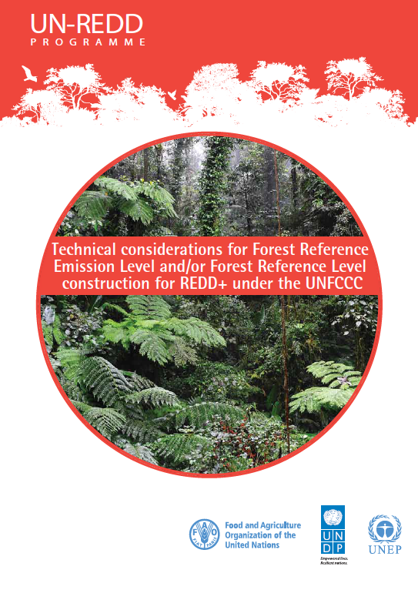
Setting Forest Reference Levels (FRLs)
Estimate national baseline for future GHG emissions or removals in absence of REDD+ actions
Estimate future GHG emissions with REDD+ actions
FRLs are basis for results payments
  If too low: reduces confidence in program
  If too high: decreases potential payments
Measurement, reporting, and verification (MRV)
Report results against the FRL in country’s Biennial Update Reports
Notes:
Note – RLs should not be low or high. They should neither over nor underestimate what would have expected in the absence of additional action. (Or be a historical average, if the initiative so requires.)
Should this be reversed? High baselines (especially inflated) increase the potential emissions reductions:
FRLs are basis for results payments
If too low: reduces confidence in program
If too high: decreases potential payments

Slide 17
Issues in Establishing Reference Levels (Baselines)
Counterfactual: Future conditions in absence of project
  Difficult to estimate
  Modeling requires data
  Many assumptions
Data requirements
  Historic data available on national deforestation rates since 1990
  Little historic data on GHG emissions from forest degradation
  Carbon stocks (tCO2e/ha) by type and expected change
International discussions on allowing baselines to be historic emissions or lower
  May be slightly above historic emissions for high forest/low deforestation countries (e.g., in Congo basin)

Slide 18
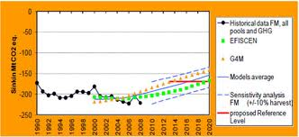
Use of Multiple Land Use Models
Multiple land use models often used to predict reference levels
  Results often averaged across models
    Not necessarily a good predictor
    Some models may have better scientific basis or data than others
  Sensitivity analysis: How changes in models selected or key assumptions affect estimated baselines and with project
  Global economic trends and technological changes can change emission trends, but historical emissions are starting point for estimating baseline
Notes:
There are two points here. One, there are many competing views of what the baseline would be. Two, remember yesterday, the benefit is the difference between what occurs and the baseline. We can have emissions, but if those emissions are less than the baseline we have a benefit. Not all reduction will count as credits. Countries will take some actions unilaterally, and may negotiate crediting baselines.
S^{B}_{t} = A^{B}_{t}*D^{B}_{t}
A^{B}_{t} = Forest area in baseline, year t
D^{B}_{t} = Carbon density of forest area
Baseline emissions = change in S^{B} from year t-1 to year t

Slide 19
GHG Net Emissions Reductions
Crediting baseline
  Estimated carbon stock in project area at future time periods in absence of the project (“without project”)
Project emissions: estimated GHG releases in the project boundaries
  Ex ante: estimated before project
  Ex post: actuals measured during or after the project
    Easier since well established methods for measuring carbon stocks and changes
    Still requires skills and training
Net emissions reductions
  Difference between crediting baseline emissions and actual project emissions at future time periods
  Initial basis for carbon reduction credits (before adjustments)
Notes:
“Net emissions reductions”
This is the equation stating that the credits issued are the project emissions from one period to the next, minus the baseline emission for the same period, minus adjustments. Typical adjustments are for uncertainty and risk of reversal.
C^{C}_{t} = [S^{P}_{t} – S^{P}_{t-1}] – [S^{B}_{t} – S^{B}_{t-1}] – adjustments
Where
C^{C}_{t} = Credits issued at the end of time t (tCO2e)
S^{P}_{t (t-1)} = Observed carbon stock in place in the project area at the end of period t (t-1)
S^{B}_{t (t-1)} = Crediting baseline: Estimated carbon stock that would be in the project area at the end of period t (t-1) if the project did not take place

Slide 20
Crediting Baselines Only Count Part of Emission Reductions from BAU
Optimal Reference Level Setting for REDD+, REDD-Net, 2010
Notes:
The difference between the BAU baseline and crediting baseline accounts for uncertainty and unilateral actions.
http://theredddesk.org/resources/optimal-reference-level-setting-redd

Slide 21
Additionality
Additionality: Demonstrate that planned GHG mitigation actions would not have happened under BAU
  Crucial at project scale, relevant at jurisdictional scale, not relevant for national accounting
  Easiest to do with projects involving businesses holding official permits for forest clearing/land development
  How to address in reducing emissions from protected areas
  Challenging to demonstrate for conservation
Additionality was important issue for project-based REDD+
Additionality not required in most jurisdictional REDD+
  Baselines expected to reflect ongoing activities
  Expected to demonstrate that new activities have been implemented

Slide 22
Carbon Credit Adjustments
Uncertainty deductions by credit registries:
  Reductions (“haircuts”) in projected carbon credit payments to allow for underachievement
Leakage: Deforestation or forest degradation displaced to other locations within or across countries, reducing global net benefits
  Displacement of GHG emissions to other sectors
    Replacing woodfuels with petroleum-based fuels
    Replacing construction wood with brick
  Less of an issue if REDD+ implemented at jurisdictional level, but still a possible concern across countries
Permanence
  Buffers to protect against carbon reversals: Future losses of already credited carbon from natural or anthropogenic disturbances
  Buffers can be released if uncertainty decreases
Notes:
Leakage is less of an issue when REDD+ is implemented at a national or subnational level, as there can be no domestic leakage once full national coverage is achieved. However, there can still be international leakage if activities are displaced across international borders, or "displacement of emissions" between sectors, such as replacing wood fires with kerosene stoves (AFOLU to energy) or construction with wood for construction with concrete, cement and bricks (AFOLU to industry). Many initiatives require leakage be taken into account in program design, so that potential leakage of emissions, including across borders, can be minimized

Slide 23
Measurement, Reporting, and Verification (MRV)
  Complex MRV requirements to receive results-based payments are technically challenging
  Forest degradation difficult to measure and site-specific
  No standard methods for estimating GHG impacts of conservation and sustainable management of forests
May be too costly for some REDD+ actions compared to the benefits
New approaches to MRV being tested for forest degradation under Forest Carbon Partnership Facility’s Carbon Fund
Notes:
Lots of new approaches being tested on degradation under the FCPF Carbon Fund

Slide 24

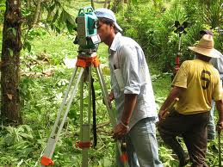
Analyzing REDD+ Costs
Start-up costs
  Project planning and analysis
  Negotiate with participants
  Validate and verify GHG emissions and removals
  License fees
Implementation costs
  Initial capital costs
  Ongoing operating, maintenance, and replacement costs
  MRV costs

Slide 25
Land and Carbon Rights Issues
Land and resource tenure rights often unrecognized, overlapping or violated in many countries
  Can generate mistrust, opposition to mitigation efforts
  Can reduce effectiveness of incentives
  Importance of transparency and fairness to avoid and handle disputes
Concerns may be greater at jurisdictional level

Slide 26
Other Concerns With REDD+
Natural, native forests vs. monoculture exotic tree plantations
  Different effects on biodiversity and environmental services
  Risks of pests, diseases, and fire vary
  Risks of logging and land use conversion vary
Sustainability of donor funds vs. market-based approaches
  Carbon taxes and prices less important as funding sources than expected
  Donor funding may decrease
Top-down vs. bottom-up (grassroots) design

Slide 27
UNFCCC Safeguards to Avoid Negative Impacts of REDD+
Countries report regularly on how safeguards have been addressed
Consistency with national forest objectives and programs, and international agreements
Transparent and effective national forest governance
Respect for the knowledge and rights of indigenous peoples and local communities
Free, prior and informed consent -- part of U.N. Declaration on Rights of Indigenous Peoples, but no explicit UNFCCC requirement for REDD+
Full and effective participation of relevant stakeholders
Consistency with environmental and social benefits from conservation of natural forests, ecosystem services, and biodiversity
Address risks of reversals
Reduce displacement of emissions
Notes:
https://unfccc.int/resource/docs/2010/cop16/eng/07a01.pdf

Slide 28
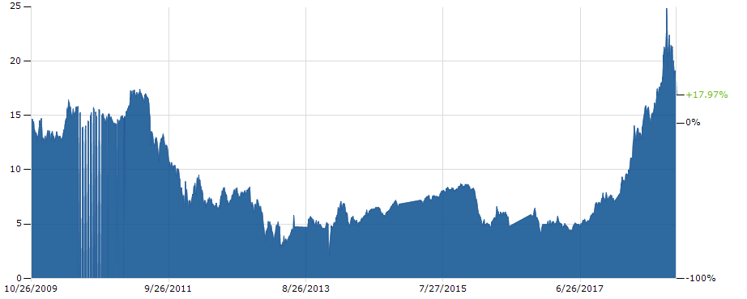
European Union Compliance Markets
Buyers meeting regulatory requirements (EU Emissions Trading System)
  Quantity and prices lower than expected
    EU issued many free credits
EU CO2 Emission Allowance Prices, October 2009-October 2019 (Euros/tCO2e)
Notes:
€16.87 October 31, 2018
Note – does not include land use
Carbon benefits ($) = C^{C}_{t} * V^{C}_{t}
C^{C}_{t} = Credits issued at time t (tCO2e)
V^{C}_{t} = Market value of credits at time t ($/tCO2e)

Slide 29
Voluntary Markets
  Buyers interested in purchasing carbon credits
    Real: evidence that project removes or prevents emissions
    Additional: emissions reductions would not occur without project
    Measurable: emissions reductions can be accurately quantified
    Verifiable: neutral, third-party auditor certified emissions reductions
  Prices generally low, but varied a lot
  Quantity demanded lower than expected
Small projects may have difficulty selling carbon credits
Issuances: New credits that can be resold
Retirements: Period when end buyers can claim emission reductions, but existing credits cannot be resold
Notes:
Carbon benefits ($) = C^{C}_{t} * V^{C}_{t}
C^{C}_{t} = Credits issued at time t (tCO2e)
V^{C}_{t} = Market value of credits at time t ($/tCO2e)

Slide 30
Prices on U.S. Compliance and Fair Trade Voluntary Market in 2018 ($/tCO₂E)
    U.S. Regional Greenhouse Gas Initiative: $4.50 (September 5)
    California Air Resources Board: $14.58 (May auction)
    Fair trade (voluntary market) minimum prices varied by project type
  Energy Efficiency – €8.20 + 1€ Fairtrade premium
  Renewable Energy – € 8.10 + 1€ Fairtrade premium
  Forest Management – €13 + 1€ Fairtrade premium
Notes:
Fairtrade minimum prices https://www.goldstandard.org/blog-item/carbon-pricing-what-carbon-credit-worth
EU prices https://markets.businessinsider.com/commodities/co2-emissionsrechte

Slide 31
Voluntary Carbon Market Offsets, 2005-2018 Q1
Source: Hamrick and Gallant 2018

Slide 32
Voluntary Carbon Offset Projects, 2008-2018 Q1
Source: Hamrick and Gallant 2018

Slide 33
Volume and Number of Carbon Offset Sales by Price, 2018 Q1
Source: Hamrick and Gallant 2018

Slide 34
Major REDD+ Funders (I)
Forest Carbon Partnership Facility (FCPF) (managed by World Bank)
  46 countries participating in Readiness Fund ($0.4 billion)
  19 countries participating in Carbon Fund ($0.9 billion)
    2025 end date; additional countries unlikely
Carbon Fund (nongovernmental foundation based in U.S.)
Norwegian International Climate and Forest Initiative
International Tropical Timber Organization (ITTO)
Government of Finland/Food and Agriculture Organization of the United Nations (FAO)
International Forest Carbon Initiative (Australia)
REDD Early Movers, UN-REDD
Notes:
Forest Carbon Partnership Facility The World Bank plays an important role in the development of REDD+ activities since its inception. The Forest Carbon Partnership Facility (FCPF) was presented to the international community at COP-13 in Bali, December 2007. Recipient countries can apply $3.6 million towards: the development of national strategies; stakeholder consultation; capacity building; development of reference levels; development of a national forest monitoring system; and social and environmental safeguards analysis.^{[25]} Those countries that successfully achieve a state of readiness can apply to the related Carbon Fund, for support towards national implementation of REDD+.^{[26]}
Carbon Fund
https://carbonfund.org/
Provides carbon offsetting and greenhouse gas reduction options to individuals, businesses, and organizations. It purchases and retires certified carbon offsets on behalf of its donors.
Norwegian International Climate and Forest Initiative (NICFI) provided US$1 billion for REDD in Brazil and US$500 million for REDD+ activities in Tanzania. NICFI and Government of the United Kingdom contributed $200 million for the Congo Basin Forest. In 2010, Norway signed a Letter of Intent to provide Indonesia up to US$1 billion if good results occurred.
The United States Government provided more than $1.5 billion in support for REDD+ and other sustainable landscape activities. It supported multilateral partnerships including the FCPF, as well as global programs such as SilvaCarbon, which provides support to REDD+ countries on measuring and monitoring forests and forest-related emissions. The USG also provides regional and bilateral support to countries implementing REDD+.
ITTO The International Tropical Timber Organization (ITTO) with initial funding of US$3.5 million from Norway.
Government of Finland and FAO signed a US$17 million partnership agreement in 2009 to provide tools and methods for multi-purpose forest inventories, REDD+ monitoring and climate change adaptation in five pilot countries: Ecuador, Peru, Tanzania, Viet Nam and Zambia
Australia Australia established a A$200 million International Forest Carbon Initiative, focused on developing REDD+ activities in Indonesia and Papua New Guinea.
Interim REDD+ Partnership. In 2010, national governments of developing and developed countries created for early action and fast start finance for REDD+ actions.

Slide 35
Major REDD+ Funders (2)
Biocarbon Fund for Sustainable Forest Landscapes (ISFL)
  Integrated forest landscapes (forests, agriculture, and other land uses)
  Up-front grants
  Private sector partnerships
  Results-based payments for net emission reductions
  Results-based payments
  Currently 5 partner countries
Green Climate Fund
  Supports mitigation and adaptation proposal submitted by countries
  Includes private sector window
  Phase 1 and phase 2 funding
  Additional $500 million set aside for RFP for results-based payments

Slide 36
REDD Acceleration Fund
Rockefeller Foundation grant to Environmental Defense Fund
Partners: Climate and Forest Capital LLC; Baker & McKenzie law firm ; Government of Norway
National and subnational governments of countries with tropical forests in Africa, Asia, and Latin America
Investment fund in feasibility and design stage (design still evolving)
  Create sustainable long-term demand for REDD+ credits
  Reduce risk of pre-compliance market REDD+ investments
  Sell options on future compliance credits for California, international aviation, and other post-Paris compliance carbon markets
Target investors: corporations, high-net worth individuals, multilateral development finance institutions, and bilateral donors

Slide 37
How REDD+ Acceleration Fund Will Work
Notes:
https://assets.rockefellerfoundation.org/app/uploads/20170706180732/Redd-Acceleration-Fund.pdf

Slide 38
New Funding Sources for REDD+
CORSIA: International Civil Aviation Organization’s new sectoral cap-and-trade program
  Voluntary 2021-2026
  Mandatory 2027-2035
  Guidance currently under development aviation industry
  Only allows jurisdictional REDD+ to avoid leakage
  Cannot be double counted toward country NDCs
California’s Tropical Forest Standard
  October 2018 draft open for public comment
  Criteria for jurisdictional offset credits that reduce GHG emissions in tropical forests
  Eligibility for California’s cap-and-trade program

Slide 39
Potential Opportunities for USAID REDD+ Support
Help define relationships of projects to nationally determined contributions and national REDD+ strategy
Identify existing and new sources of REDD+ finance
Support development of financing proposals
Help partners engage with private sector
Bring national planning and policy to subnational level
Promote jurisdictional approaches to REDD+
Help create effective monitoring, reporting and verification (MRV) systems for planning, implementation, and management (Notman 2018)

Slide 40
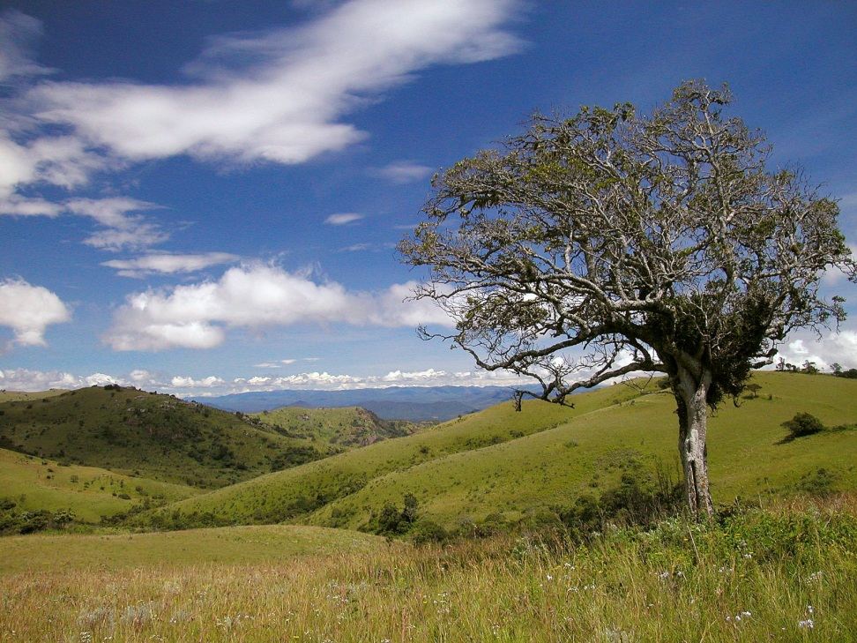
SILVACARBON Program
Part of U.S. fast-start financing for REDD+
Contribution to the GEO Global Forest Observation Initiative (GFOI)
  Partners with developing countries to improve monitoring of forest and terrestrial carbon
  Improves understanding of methods for data collection, analysis and dissemination
  Coordinates U.S. science, innovation, and technical expertise (Notman 2018)

Slide 41

USAID Supports MRV Work of Other USG Agencies
U.S. Forest Service
    Bangladesh: Sundarbans mangroves
    Brazil: inventory design and MRV system
    Indonesia: peat lands and mangroves
NASA – Regional Visualization and Monitoring System (SERVIR)
    Mapping and data integration
    Capacity building with partner organizations in regional hubs
    Mesoamerica, Eastern Africa, Hindu Kush, Mekong (coming soon)
U.S. Environmental Protection Agency (GHG inventories, ALU Tool for estimating emissions from agriculture and land use)
US Geological Survey
Notes:
Some of the practical aspects of implementing these MRV systems are exemplified by the various U.S. government agencies involved in supporting an effort known as SilvaCarbon. This is a flagship program under U.S. fast start financing for REDD+, as committed under the Copenhagen Accord that we discussed yesterday. This is a whole of government initiative involving USAID as the lead agency, and technical expertise from the U.S. State Department, U.S. Geological Survey, U.S. Forest Service, National Aeronautical and Space Administration (NASA), U.S. Environmental Protection Agency (EPA), National Oceanographic and Atmospheric Administration (NOAA), and the Smithsonian Institution, along with universities, non-profit organizations, and industry. SilvaCarbon aims to: (1) enhance capacity worldwide to understand, monitor, and manage forest and terrestrial carbon; (2) partner with developing countries and others to identify, test, and disseminate good practices, and cost effective, accurate technologies and methodologies; and (3) coordinate and utilize the substantial assets of the U.S., including data and analyses, technology, and technical expertise.
USAID recently awarded a task order for the global Forest Carbon, Markets, and Climate (FCMC) initiative that will provide technical and logistical assistance to USAID and partner countries on implementing the USG REDD+ Strategy, including support to national REDD+ Readiness in selected countries. We have mentioned the U.S. Forest Service a few times already. Some specific examples of the kinds of support they are providing are listed here.
In addition to these USG examples, a large number of research institutions and others are working on ways to lower the costs and increase the accuracy of conducting carbon stock assessments in tropical forests. Satellite imagery is a relatively mature technology that has demonstrated its usefulness in monitoring land-use and land-use changes over time. On a per-hectare basis, it is one of the most cost effective ways to track the hectares of forest land in a country, region, or even globally. A disadvantage is that because the satellites are operating at high altitudes, they are less accurate in determining tree heights, understory species, or other aspects necessary to track carbon stocks per hectare.
Light Detection and Ranging, or LIDAR, is an optical remote sensing tool that is one of the several emerging technologies which holds promise for addressing this shortcoming of satellite imagery. LIDAR works similarly to radar, but uses light waves from lasers. It is used widely to produce digital elevation models of the earth, where high resolution provides very accurate mapping of subtle changes in the surface. LIDAR has also found some applications in forestry that are pertinent to our discussion. LIDAR makes it possible to determine how tall a tree is, as well as its biomass and leaf area. These measurements can then be used to calculate carbon stocks per hectare. Some limitations of LIDAR for this purpose are the high cost of collecting data (it requires aircraft flying about 700 meters above the surface, and they can collect data only on a path 300 meters wide) and a steep learning curve understanding its use. For example, calibrating the data with ground observations to validate and verify accuracy.
As we have mentioned several times already, the trade-off between cost and accuracy is a constant in MRV systems. We can think of it as a continuum. On one end of the spectrum we have highly accurate, very precise data that are very expensive to collect. On the other end of the spectrum are low quality data obtained at relatively low cost. Decisions about where along this spectrum is optimal for a given set of country circumstances can have important consequences in terms of the “quality” of carbon credits potentially available for trade in an eventual market.

Slide 42
UN-REDD Support
Collaborating organizations
  Food and Agriculture Organization of the United Nations (FAO)
  United Nations Development Program (UNDP)
  United Nations Environment (UNEP)
Supports nationally led REDD+ processes
Promotes stakeholder involvement, including indigenous people and other forest-dependent communities

Slide 43
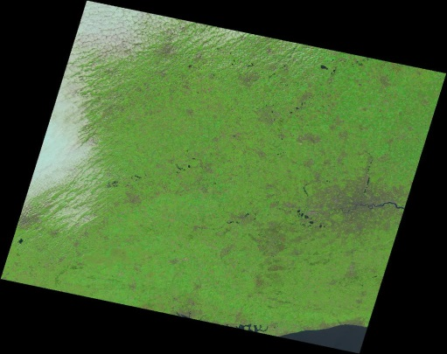
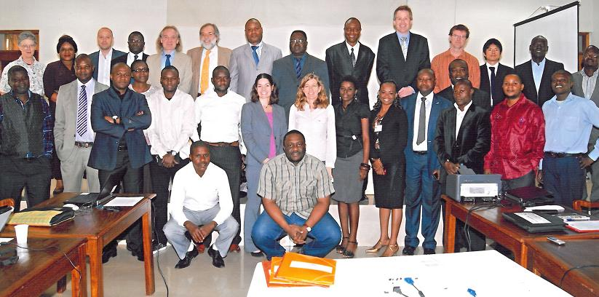

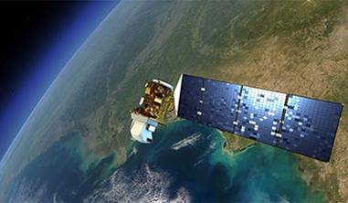

Global Forest Observation Initiative (GFOI)
Space Data
  GFOI ensures the acquisition of core satellite data
Capacity Building
  GFOI provides capacity building in coordination with others such. It supports the use of satellite and ground data to monitor forests, and estimate GHGs.
  SilvaCarbon
Methods and Guidance
  Report guiding the use of Satellite and Ground data for national forest monitoring and estimation of carbon stocks and greenhouse gas emissions.
Research and Development
  Identifying and promoting R&D needed for practical, global implementation of National Forest Monitoring
GFOI Office
  Coordination and Management

Slide 44
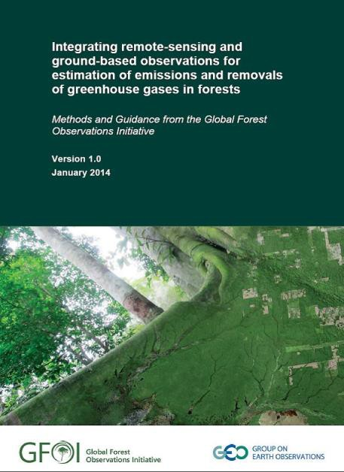
GFOI Methods and Guidance Document
Links IPCCC methods and REDD+ activities
Consistent with UNFCCC Warsaw Framework on REDD+
Coordinated with UN-REDD, World Bank, IPCC and GOFC-GOLD
For policy and technical decision makers in REDD+ countries and their development partners

Slide 45


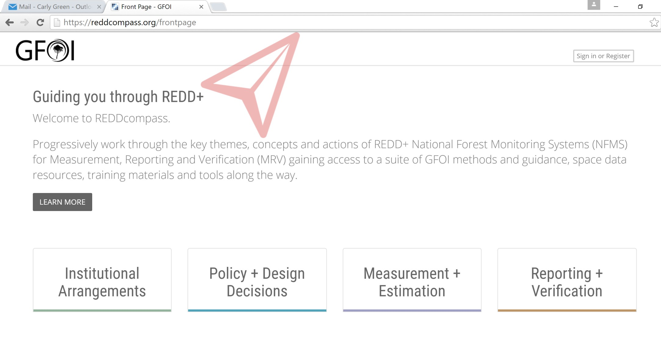
REDDcompass Website
https://www.reddcompass.org/frontpage

Slide 46
References (1)
Chages, Thiago et al. 2011. Nested Approaches to REDD+: An Overview of Issues and Options. Washington, DC: Forest Trends and Climate Focus, Prepared for USAID.
FAO. 2015. Technical Considerations for Forest Reference Emission Level and/or Forest Reference Level Construction for REDD+ under the UNFCCC. Rome: Food and Agriculture Organization of the United Nations
Forest Carbon Partnership Facility. 2013. A Guide to the FCPF Readiness Assessment Framework. Washington, DC: World Bank. In English, French, and Spanish at https://www.forestcarbonpartnership.org/readiness-fund-0.
GFOI. 2016. Integration of Remote-sensing and Ground-based Observations for Estimation of Emissions and Removals of Greenhouse Gases In Forests: Methods and Guidance from the Global Forest Observations Initiative, Edition 2.0, Rome: Food and Agriculture Organization of the United Nations.
Griscom, Bronson et al. 2017. “Natural Climate Solutions.” PNAS October 31. 114 (44) 11645-11650; https://doi.org/10.1073/pnas.1710465114
Hamrick, Kelley and Melissa Gallant 2018. Voluntary Carbon Markets: Outlooks and Trends, January to March 2018. Washington, DC: Forest Trends Association.
Kauffman, J. Boone et al. “Carbon Stocks of Mangroves and Salt Marshes of the Amazon Region, Brazil.” Biology Letters (2018). DOI: 10.1098/rsbl.2018.0208
IPCC. 2014: Synthesis Report. Contribution of Working Groups I, II and III to the Fifth Assessment Report. Geneva: Intergovernmental Panel on Climate Change.

Slide 47
References (2)
Notman, Evan. 2018. “Approaches to Sustainable Landscapes Programming.” Powerpoint for the USAID Advanced Sustainable Landscapes Training. Washington, DC: USAID.
Ogonowski, Matthew and Gordon Smith. 2014. “Integrating Economic and Policy Analysis in Sustainable Landscapes for Low Emission Development.” Powerpoint for Training on Economic Analysis and Planning of Climate Change Mitigation in Mozambique. Washington, DC: Crown Agents-USA and USAID.
Parra, Angel et al. 2014. REDD+ Measurement, Report, and Verification (MRV) Manual Version 2.0. Burlington, VT: Tetra Tech, Prepared for USAID.
Smith, Gordon; David Cooley; and Eric Hyman. 2018. The Impacts of Rural Road Development on Forests, Greenhouse Gas Emissions, and Economic Growth in Developing Countries. Washington, DC: Crown Agents USA, and Abt Associates.
Smith, Gordon; Eric Hyman; Michelle Manion; Jason Vogel; and David Cooley. 2018. Greenhouse Gas and Other Environmental and Economic Impacts of Hydropower in the Tropics: A Literature Review. Washington, DC: Crown Agents-USA and Abt Associates.
Smith, P. et al. 2014. “Agriculture, Forestry, and Other Land Use.” in Edenhofer, O. et al. (eds.) Mitigation of Climate Change, Contribution of Working Group III to the Fifth Assessment Report of the Intergovernmental Panel on Climate Change. New York: Cambridge University Press.

Slide 48
References (3)
Stratos, Kathryn and Lexine Hansen. 2018. “Sustainable Landscapes: Updating Our Vision.” Powerpoint for the Advanced Sustainable Landscapes Training. Washington, DC: USAID.
Tembo, Catherine. 2018. “Zambia’s SL REDD+ Community Forestry Program.” Lusaka: USAID/Zambia powerpoint for the USAID Advanced Sustainable Landscapes Training.
Tubiello, Francis. 2014. “Agriculture Forest and Other Land Use – AFOLU. Rome: Food and Agriculture Organization of the United Nations. Working Group III contribution to the IPCC Fifth Assessment Report.” https://www.ipcc.ch/pdf/unfccc/sbsta40/AR5WGIII_Tubiello_140606.pdf

Slide 49
Other Web Resources
ClimateLinks (www.ClimateLinks.org)
EC-LEDS.org tools
AFOLU Carbon Calculator (afolucarbon.org)
GHG Inventory Templates for ALU
Global Forest Watch (globalforestwatch.org)

Slide 50
ANNEX SLIDES

Slide 51
Deforestation and Forest Degradation
Deforestation: long-term conversion of forests to non-forest land uses
Forest degradation: reductions in the tree biomass on previously forested land that has not been converted to long-term non-forest uses
Greenhouse gases (GHGs): gases that contribute to global warming by absorbing and re-radiating heat in the atmosphere back to Earth
Agriculture, forestry, and other land uses (AFOLU): 20-24% of anthropogenic (human-induced) GHG emissions
  Deforestation and forest degradation alone – 17% of carbon emissions
Notes:
Forest definition for UNFCCC reporting) uses patch size, height at maturity, and canopy cover. Woodlands and bush count as forest.
https://www.unredd.net/about/what-is-redd-plus.html
IPCC 2014

Slide 52
Greenhouse Gases
GHGs vary in global warming effect and persistence in atmosphere
  Carbon dioxide (CO₂)
    Persists 200-450 years
    Global warming potential (GWP) =1 since other GHGs expressed in metric tons of CO₂ equivalent (tCO_{2e}) over 100 years
  Methane (CH₄)
    Persists 9-15 years
    GWP = 21 for UNFCCC and REDD+ reporting (U.S. Environmental Protection Agency = 25; IPCC (2013) with feedback effects = 34)
  Nitrous Oxide (N₂O)
    Persists 120 years
    GWP = 310 (IPCC = 298)
  Other GHGs: Fluorinated gases, ozone, and water vapor
Notes:
Hydrofluorocarbons, perfluorocarbons, sulfur hexafluoride, and nitrogen trifluoride are synthetic, powerful greenhouse gases that are emitted from industrial processes.

Slide 53
Forests, Agriculture, and Global Warming
Forests are major carbon sinks because photosynthesis converts atmospheric CO₂ to biomass
  Deforestation and forest degradation reduce this future carbon sequestration (storage)
  Aerobic decomposition (with sufficient oxygen) or burning of above- and below- ground organic matter releases CO₂
  Anaerobic decomposition of organic material (with low oxygen) produces methane
    Wetland and peat soils (swamps, mangroves, and large reservoirs)
      Mangroves = 0.6% of tropical forest area
      Mangrove clearing = 12% of GHG emissions from tropical deforestation
Conversion of forests to agriculture or livestock production also generates GHGs
  Methane from livestock and flooded rice farming
  N₂O from nitrogen fertilizers
Notes:
Frame this as a question for the class – answer is “all of the above”
No single definition exists for Low Emission Development Strategies, or LEDS, either. For the purposes of this training, a LEDS is “a strategic economic development and environmental planning framework that articulates actionable programs and policies to put a country on a climate-resilient development path while working toward long-term measurable GHG emission reductions.”
One way to state it simply is to say that a LEDS outlines how you bend the emissions curve.
Do note the word “actionable,” one of such qualities, which means that LEDS are not just a planning exercise but also include implementation and financing.
There is also no one-size-fits all LEDS, as LEDS reflect a country’s unique circumstances and build on existing frameworks and country progress in addressing climate change. However, LEDS do have common essential qualities, as we will discuss later.

Slide 54
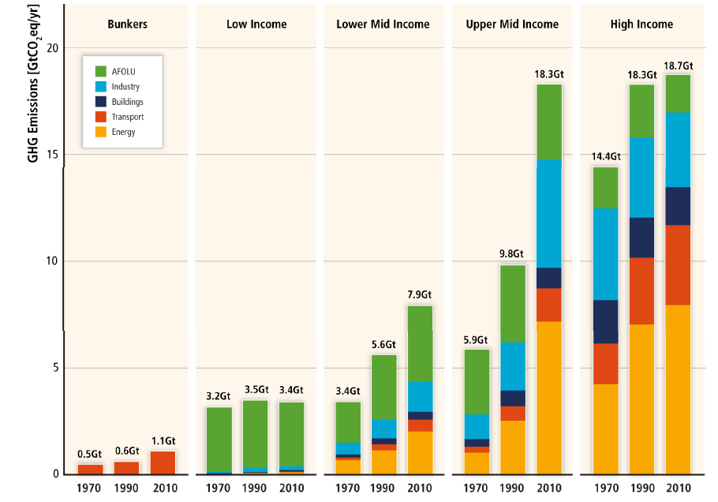
Land Use Emissions in Developing Countries
Allocation of GHG emissions across sectors and country income groups
Notes:
AFOLU = agriculture forestry and other land use.
Poor country emissions are mostly land emissions. Higher income developing countries still have land emissions, but have much larger fossil fuel emissions so land emissions are a modest percent of their national inventories.

Slide 55
Sources of AFOLU Emissions
Notes:
IPCC 2014.

Slide 56
Mitigation Potential From AFOLU
Notes:
IPCC 2014. Chapter 11

Slide 57
IPCC Assessment on AFOLU Emissions Reduction
Crops and livestock are primary sources
Supply- and demand-side options can reduce AFOLU emissions 80% by 2030
Land-use competition can be limiting
Positive linkages from reducing AFOLU emissions on sustainable development and climate adaptation
  Case- and site-specific
  Depend on scale, scope, and pace of implementation
Good governance essential to reduce barriers and obtain benefits (Tubiello 2014)

Slide 58
Potential of Natural Climate Solutions
Grissom et al. (2017): potential GHG reductions from natural climate solutions 30% higher than prior estimates
1/2 of potential costs less than $100/tCO_{2e}
1/3 of potential costs less than $10/tCO_{2e}
Most have additional benefits if effectively implemented
  Water filtration
  Flood buffering
  Soil health
  Biodiversity habitat
  Climate adaptation

Slide 59
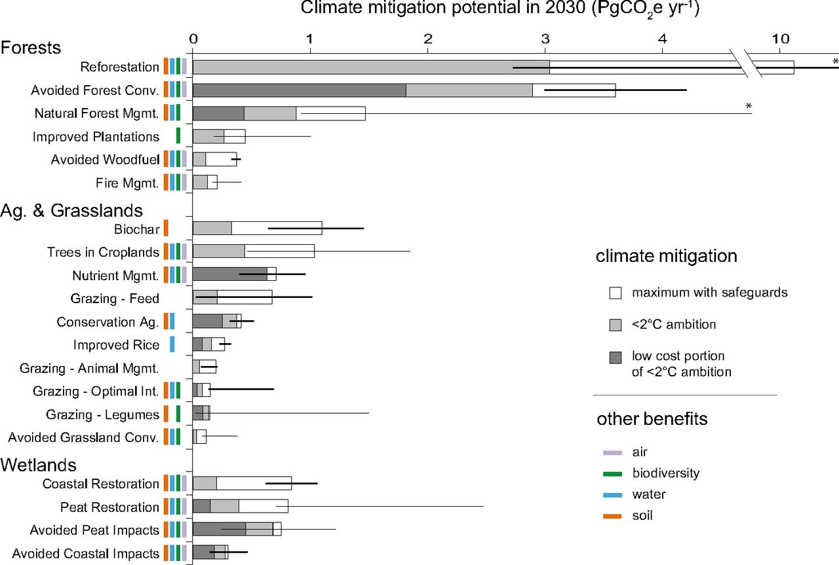

Climate Mitigation Potential of 20 Natural Climate Solutions
©2017 by National Academy of Sciences
Bronson W. Griscom et al. PNAS 2017;114:44:11645-11650
Notes:
Climate mitigation potential of 20 natural pathways. We estimate maximum climate mitigation potential with safeguards for reference year 2030. Light gray portions of bars represent cost-effective mitigation levels assuming a global ambition to hold warming to <2 °C (<100 USD MgCO₂e⁻¹ y⁻¹). Dark gray portions of bars indicate low cost (<10 USD MgCO₂e⁻¹ y⁻¹) portions of <2 °C levels. Wider error bars indicate empirical estimates of 95% confidence intervals, while narrower error bars indicate estimates derived from expert elicitation. Ecosystem service benefits linked with each pathway are indicated by colored bars for biodiversity, water (filtration and flood control), soil (enrichment), and air (filtration). Asterisks indicate truncated error bars. See SI Appendix, Tables S1, S2, S4, and S5 for detailed findings and sources.

Slide 60
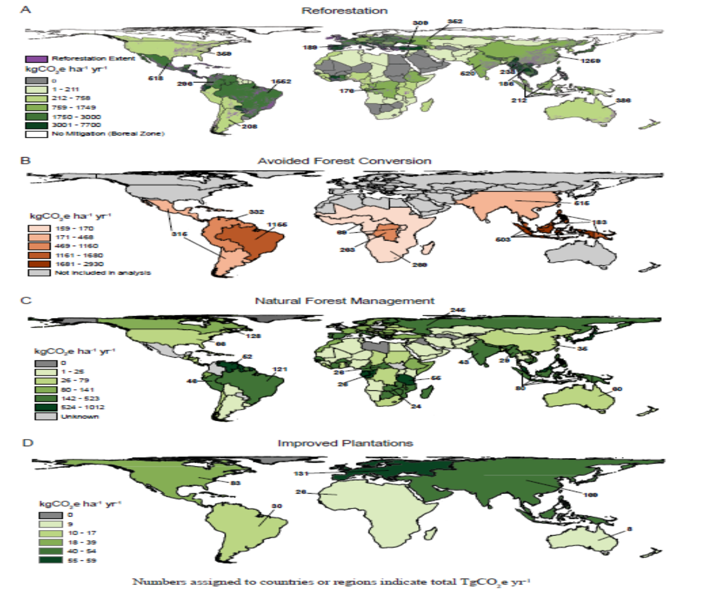
Natural Climate Solutions Potential
Source: Griscom et al. 2017

Slide 61
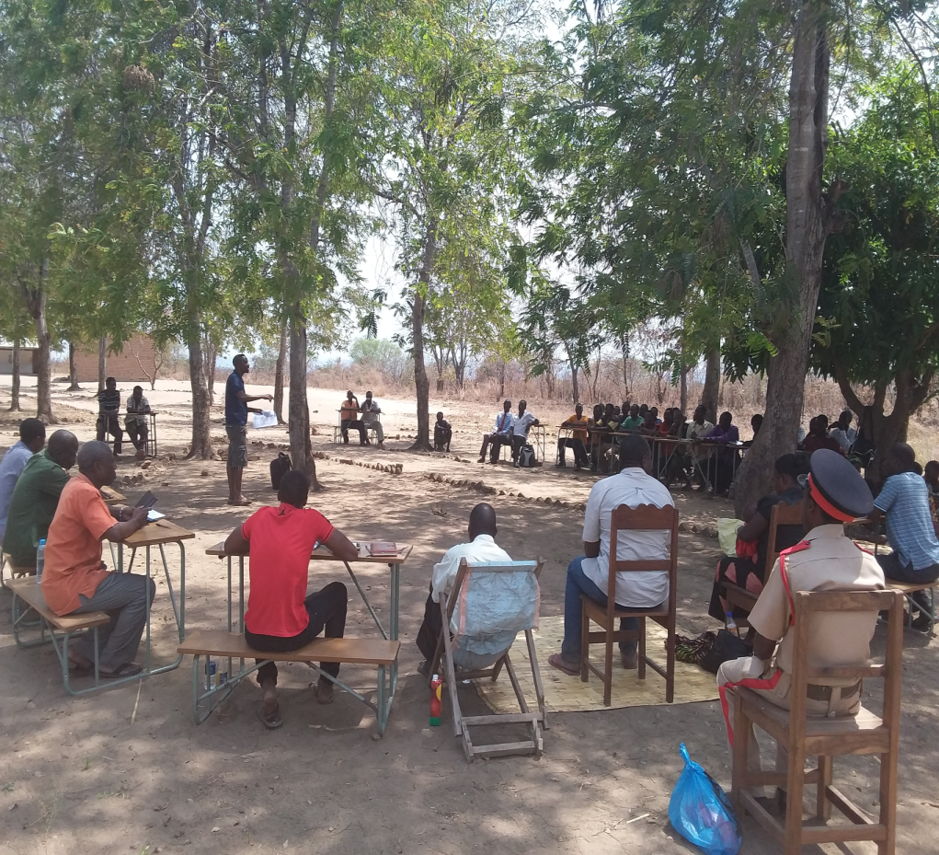
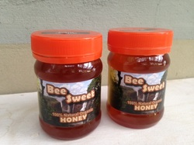
What is Working in USAID/Zambia REDD+ Activity for Forests?
Buy-in from host government
Improved collaboration with host government, traditional authorities, community-based organizations (CBOs) and community members
Capacity building of CBOs in REDD+ implementation
Community benefits – livelihoods, conservation fees
Notes:
Source: Tembo 2018

Slide 62
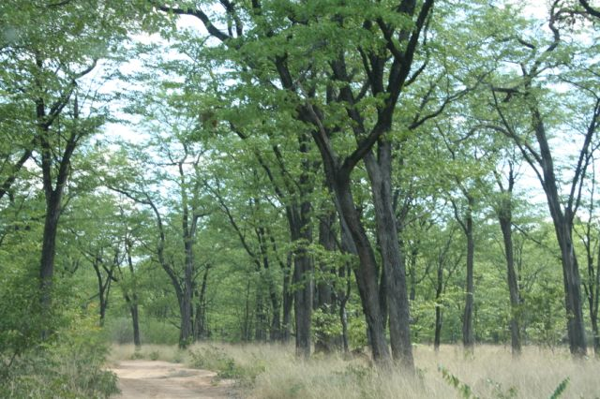
What is Not Working in USAID/Zambia REDD+ Activity?
REDD+ is relatively new and faces skepticism from some stakeholders
Government moving cautiously on REDD+ policy
Uncertainty of voluntary carbon markets
Notes:
Source: Tembo 2018

Slide 63
USAID/Zambia REDD+ Activity Outcomes
Indicator | Achievement
# of ha of biological significance under improved management | Over 700,000 ha
GHG emissions reduced or avoided | 572,000 tCO2e
# of people receiving livelihood co-benefits | 102,000
# of institutions with improved capacity to assess CC risks | 82 (government and CBOs)
# of carbon credits sold | 556,000
Notes:
Tembo 2018
$5 million activity in year 4 of 5

